Slide 1
CT for Uncomplicated Rhinosinusitis
When to Image Based on Choosing Wisely® and ACR Appropriateness Criteria®
Notes:
Standard template

Slide 2
What Is R-SCAN?
Collaborative activity for referring clinicians and radiologists to improve patient care through clinical improvement
R-SCAN Collaboration Goals:
Ensure patients receive the most appropriate imaging exam at the most appropriate time based on evidence-based appropriate use criteria
Reduce unnecessary imaging tests focused on imaging Choosing Wisely® topics
Lower the cost of care
Notes:
Standard template
Intro to what the program is about and its benefits.
Website is www.rscan.org
Time commitment: staff time dedicated to an R-SCAN project ranges from 15 to 30 hours over a three- to six-month period.
You can also gain experience using a clinical decision support (CDS) tool; gaining experience with CDS now will help referring clinicians be prepared for the implementation of federal reimbursement requirements for CDS consultation prior to ordering advanced imaging. This alternative to pre-authorization reduces time and expense for practices and patients when imaging is the next step in the diagnostic process.

Slide 3
Why Participate?
R-SCAN Offers:
Data-driven system for moving toward value-based imaging and patient care
Opportunity to focus on highly relevant imaging exams to improve utilization
Collaborators can fulfill their Improvement Activity requirements under the MIPS
Easy way to practice with clinical decision support (CDS) technology
In preparation for PAMA
Free and immediate access to Web-based tools and CME activities
Notes:
Standard template
Participants earn improvement activity credits.
More here: https://rscan.org/images/PDFs/RSCAN_Improvement-Flyer_v4.Web_09-11-17pdf.pdf
Information about Protecting Access to Medicare Act here: https://www.acr.org/Advocacy-and-Economics/Advocacy-News/Advocacy-News-Issues/In-the-April-21-2017-Issue/ACR-Answers-Frequent-Questions-About-CDS-Mandate

Slide 4
Problem: Overutilization of CT Imaging for Uncomplicated Acute Rhinosinusitis
Evidence shows that diagnosis of uncomplicated acute rhinosinusitis (lasting <4 weeks) is based on clinical criteria [1] and imaging does not modify patient care nor improve patient outcomes.
However, CT imaging of uncomplicated acute rhinosinusitis is still frequently performed, exposing patients to ionizing radiation and additional costs.
Incidental, abnormal sinus findings on CT imaging are extremely common, in up to 42% of asymptomatic healthy individuals [2, 3].
Notes:
The problem statement
More information on the issue here:
https://www.jacr.org/article/S1546-1440(16)30794-3/fulltext
References:
Rosenfeld RM, Piccirillo JF, Chandrasekhar SS, et al. Clinical practice guideline (update): adult sinusitis. Otolaryngol Head Neck Surg. 2015; 152: S1–S39.
Bolger WE, Butzin CA, Parsons DS. Paranasal sinus bony anatomic variations and mucosal abnormalities: CT analysis for endoscopic sinus surgery. Laryngoscope. 1991; 101: 56–64.
Havas TE, Motbey JA, Gullane PJ. Prevalence of incidental abnormalities on computed tomographic scans of the paranasal sinuses. Arch Otolaryngol Head Neck Surg. 1988; 114: 856–859.

Slide 5
Using Evidence to Guide Imaging Ordering
Choosing Wisely campaign
Collaborative effort between ABIM Foundation and over 70 medical specialty societies
Helps patients and medical professionals avoid wasteful or unnecessary medical tests, treatments, and procedures
Many medical associations agree that CT scans are not necessary for uncomplicated acute rhinosinusitis, including:
American Academy of Otolaryngology—Head and Neck Surgery Foundation
American Academy of Allergy, Asthma & Immunology
Notes:
Standard template
Choosing Wisely includes 150 patient-friendly resources and more than 500 specialty society provided recommendations.
Learn more: www.choosingwisely.org

Slide 6
Using Evidence to Guide Imaging Ordering
ACR Appropriateness Criteria®
Assist referring physicians and other providers in making the most appropriate imaging or treatment decisions for specific clinical conditions
Employs input of physicians from other medical specialties and societies to provide important clinical perspectives
6
Notes:
Standard template
See next slide for more info on the Appropriateness Criteria (AC).

Slide 7
ACR Appropriateness Criteria: The Facts
178 clinical imaging topics and over 875 clinical variants
Basic access is free
Learn more at acr.org/ac
7
Notes:
Standard template
New AC topics are added annually.

Slide 8
ACR Appropriateness Criteria for Sinonasal Disease
Variant 1: Acute (<4 weeks) uncomplicated rhinosinusitis.
Variant 2: Possible surgical candidate. Recurrent acute rhinosinusitis, chronic rhinosinusitis, sinonasal polyposis, or noninvasive fungal sinusitis.
Variant 3: Acute rhinosinusitis. Suspected orbital or intracranial complication.
Variant 4: Sinonasal obstruction. Suspected mass.
Variant 5: Suspected invasive fungal sinusitis.
8
Notes:
The AC variants for the specific R-SCAN topic will be in all templates.
The major clinical indications – or “variants” – are considered for each AC topic. Explain how AC works and what the variants are.

Slide 9
Appropriateness Criteria Rating by Value
9
Notes:
Standard template
Exams associated with imaging for the individual clinical indications are rated according to their value as determined by the members of the AC panels. The panels use the following approach for determining the exam’s rating, or value:
The guideline authors conduct a systematic search of scientific literature, identify most relevant articles, and develop initial ratings.
A larger panel reviews and carries out rating rounds.
Topics updated every 3 years or more frequently where needed.

Slide 10
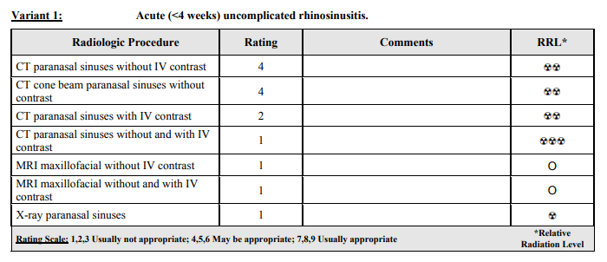
Alignment of Appropriateness Criteria and Choosing Wisely
All imaging variants and clinical scenarios: https://acsearch.acr.org/docs/69502/Narrative/
10
Notes:
An AC example for the specific R-SCAN topic will be in all templates.
All 5 variants are located here: https://acsearch.acr.org/docs/69502/Narrative/

Slide 11
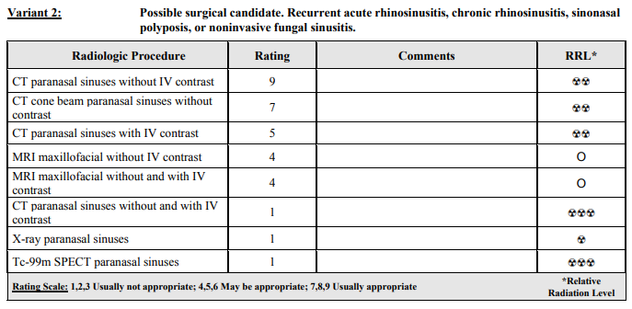
Alignment of Appropriateness Criteria and Choosing Wisely
All imaging variants and clinical scenarios: https://acsearch.acr.org/docs/69502/Narrative/
11
Notes:
An AC example for the specific R-SCAN topic will be in all templates.
All 5 variants are located here: https://acsearch.acr.org/docs/69502/Narrative/

Slide 12
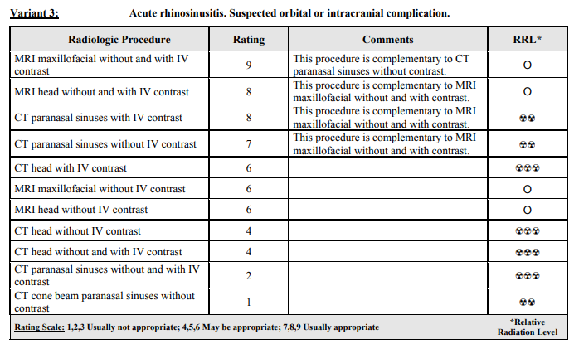
Alignment of Appropriateness Criteria and Choosing Wisely
All imaging variants and clinical scenarios: https://acsearch.acr.org/docs/69502/Narrative/
12
Notes:
An AC example for the specific R-SCAN topic will be in all templates.
All 5 variants are located here: https://acsearch.acr.org/docs/69502/Narrative/

Slide 13
Clinical Criteria for Uncomplicated Acute Rhinosinusitis
Criteria for acute, uncomplicated rhinosinusitis:
<4 weeks of purulent nasal drainage
Nasal obstruction
Facial pressure and pain
Secondary signs including anosmia, ear fullness, cough, and headache
Recurrent acute rhinosinusitis: ≥4 individual episodes of acute rhinosinusitis annually
Chronic recurrent rhinosinusitis: signs and symptoms of rhinosinusitis occur for ≥12 weeks
13
Notes:
Customized topic slide

Slide 14
When is CT for Rhinosinusitis Appropriate?
May be appropriate for:
Acute bacterial rhinosinusitis with suspected complications including headache, facial swelling, orbital proptosis, and cranial nerve palsies
Usually appropriate for:
Recurrent acute rhinosinusitis
Chronic recurrent rhinosinusitis
Noninvasive fungal sinusitis
Usually appropriate for (in conjunction with MRI):
Suspected orbital or intracranial complications
Suspected sinonasal mass
Invasive fungal sinusitis
Immunocompromised patients
14
Notes:
Customized topic slide

Slide 15
R-SCAN and Clinical Decision Support
CareSelect™ is a web-based version of the ACR Appropriateness Criteria, comprising over 3,000 clinical scenarios and 15,000 imaging indications
CareSelect provides evidence-based decision support for the appropriate utilization of medical imaging procedures
R-SCAN participants gain free access to a customized, web-based version of CareSelect, a helpful first step for aligning ordering patterns with appropriate use criteria
15
Notes:
Standard template
One of R-SCAN’s many free tools is the CareSelect CDS product, a digital version of the ACR AC. Specifically, the team uses CDS to rate the value of exams ordered for one of R-SCAN’s Choosing Wisely topics before and after an educational program is carried out.
All R-SCAN participants have free access to the web-based tool to explore the AC guidelines for other imaging topics. Consulting CDS will be a requirement for the ordering of advanced imaging for Medicare patients starting in 2019, so R-SCAN provides a good way to check out this technology.

Slide 16
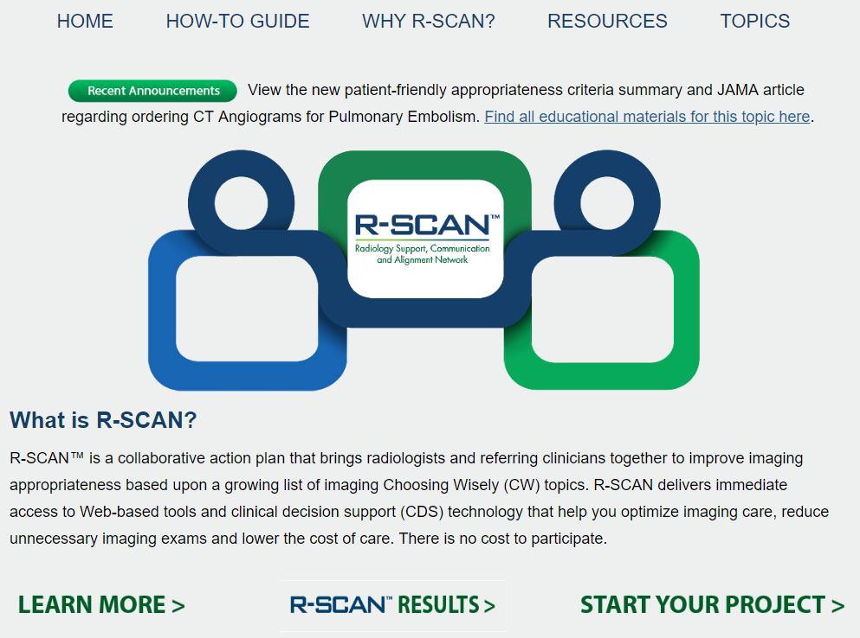
Getting Started
With
R-SCAN
rscan.org
16
Notes:
Standard template
To access ACR Select, visit the R-SCAN site and click on “Start your project.”

Slide 17
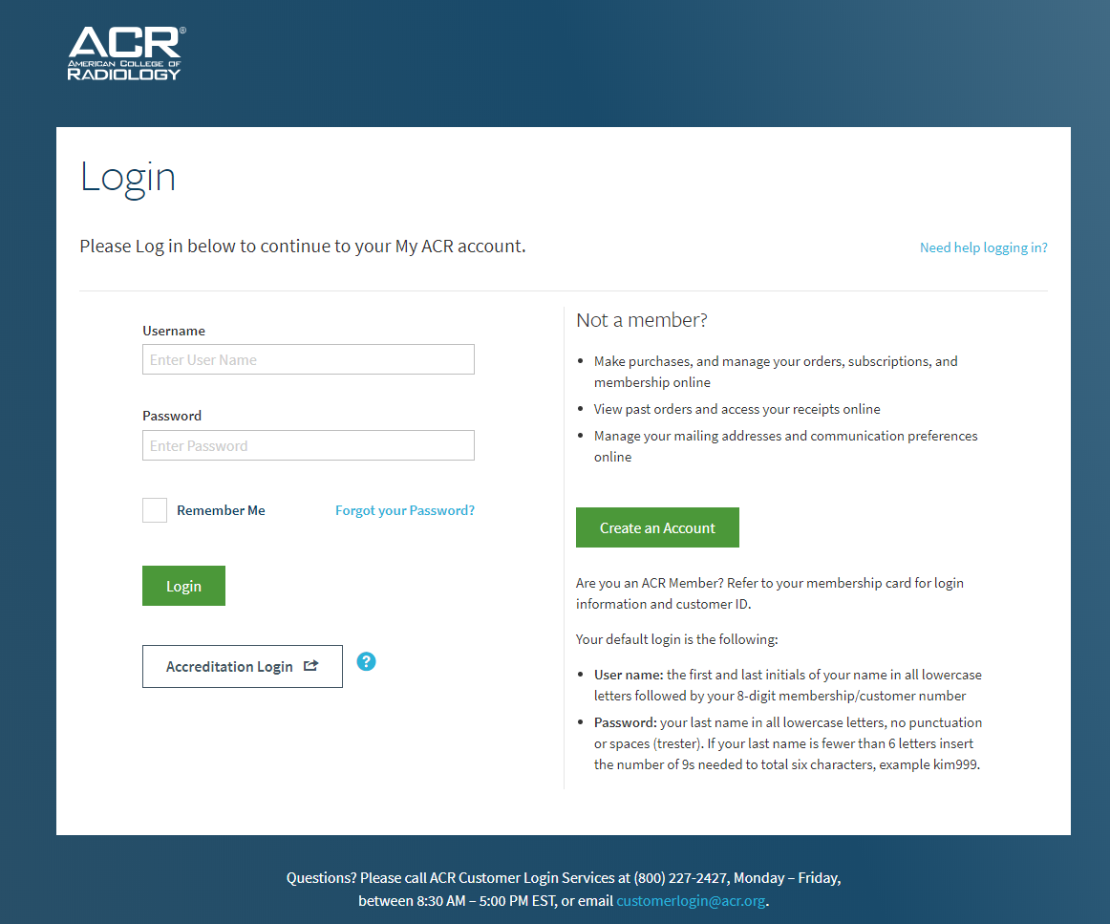
17
Notes:
Standard template
Log in with an ACR username/password. If you don’t have an ACR username and password, the R-SCAN team can provide one.

Slide 18
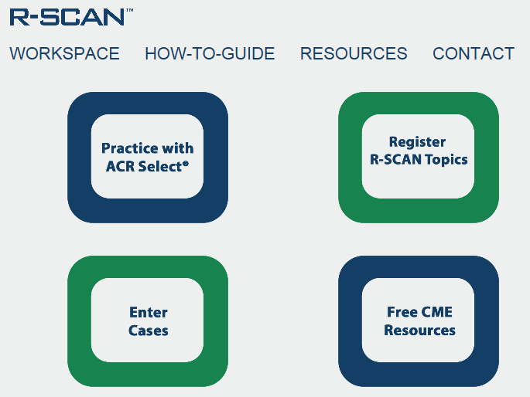
18
Notes:
Standard template
Click on “Practice with ACR Select.”

Slide 19
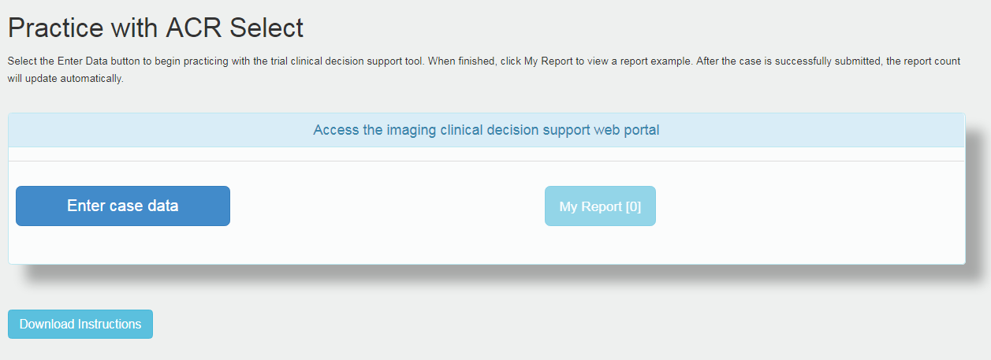
19
Notes:
Standard template
Check out the instructions for how to enter data and then click on the “Enter case data” button to explore the AC guidelines and exam ratings.

Slide 20
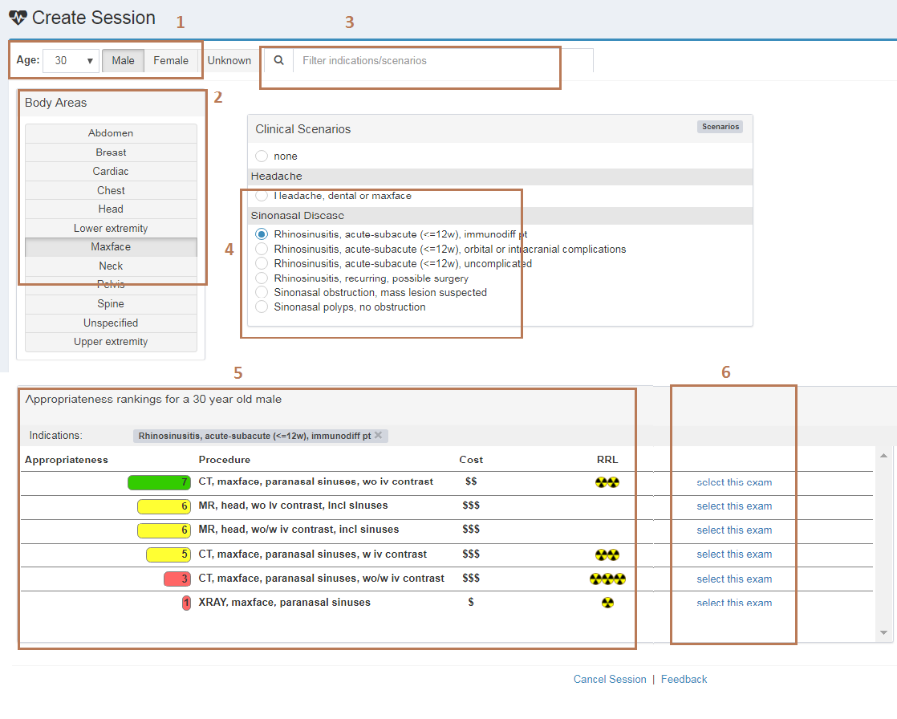
20
Notes:
Standard template
Here’s an example:
Enter a patient’s age and gender.
Select the body area of interest.
Search on a clinical indication.
Select the indication that’s the best match.
Review the appropriateness score and note the associated cost and radiation exposure.
Select the exam.

Slide 21
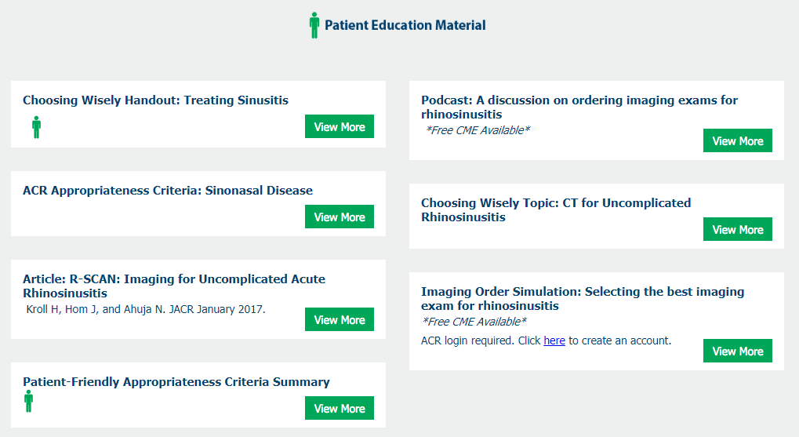
R-SCAN Uncomplicated Rhinosinusitis Educational Resources
Visit: rscan.org
Click: Resources
Click: Topic-specific Resources
Podcast
Imaging Order Simulation activity
Articles
Materials to share with patients
21
Notes:
Standard template
A library of educational materials is available for each R-SCAN Choosing Wisely topic.

Slide 22
R-SCAN Resources With CME
Podcast
A radiologist and referring physician discuss appropriate image ordering for uncomplicated acute rhinosinuitis; approved for .5 CME
Learn more
Imaging Order Simulation Activity
Test your knowledge in selecting the best imaging exam for various indications
Free with CME
Notes:
Standard template

Slide 23
Key Points: Talking With Patients
Here are talking points to explain to patients why imaging is not necessary for uncomplicated acute rhinosinusitis:
Majority of acute rhinosinusitis cases are due to viral infection which resolves in <10 days.
Evidence shows that imaging of patients with uncomplicated acute rhinosinusitis does not improve outcomes and is likely to identify incidental findings due to the commonality of abnormalities on sinus CT scans, even in asymptomatic patients.
CT scans expose you to a strong dose of radiation, which can increase your risk for cancer. In some cases, it’s the same as having about 200 chest x-rays.
Certain costs associated with imaging are not covered by insurance, such as payments to meet deductible thresholds and co-pays.
Notes:
Customized topic slide
When they’re needed, CT scans are very helpful. And the risk from a single scan is very small. But CT scans expose you to a strong dose of radiation. In some cases, it’s the same as having about 200 chest X-rays. Your body can often repair the damage CT scans cause to your tissue—but not always. And when it doesn’t, the damage could lead to cancer. The more times you’re exposed, the greater your risk of cancer.
More information for patients: https://www.jacr.org/article/S1546-1440(17)31654-X/fulltext
Patient handout: https://www.consumerreports.org/content/dam/cro/news_articles/health/PDFs/ChoosingWiselySinisitusAAAAIlow.pdf

Slide 24
Self-Assessment Question
Uncomplicated acute rhinosinusitis is characterized by (select all that are correct):
Decreased sense of smell
Nasal obstruction
≥4 individual episodes of rhinosinusitis annually
<4 weeks of nasal drainage
Notes:
Answer: B and D

Slide 25
Case 1
A 45-year-old woman presents with facial pain and postnasal drip for 6 weeks. She has no associated orbital pain or headache.
Questions:
What imaging would be most appropriate for this patient?
What other questions would you ask?
What is the focus of your physical exam?
Notes:
Each template will include a few case examples.
Answer: No imaging. Clinical judgment, combined with history and physical examination, is usually sufficient to diagnose sinusitis in most cases of uncomplicated acute and subacute rhinosinusitis. Imaging studies should be reserved for patients who develop recurrent acute sinusitis, complicated sinusitis, or chronic sinusitis with atypical symptoms, or for defining sinus anatomy before surgery.

Slide 26
Case 2
A 60-year-old woman with a history of recurrent sinusitis presents with new facial pain and postnasal drip for 5 months. She has no associated orbital pain or headache.
Questions:
What imaging would be most appropriate for this patient?
What other questions would you ask?
What is the focus of your physical exam?
Notes:
Each template will include a few case examples.
Answer: CT maxface imaging without contrast is the imaging method of choice in patients with recurrent acute sinusitis or chronic sinusitis, or to define sinus anatomy before surgery.

Slide 27
Case 3
A 28-year-old man currently on chemotherapy for lymphoma presents with new onset facial pain and pressure.
Questions:
What imaging would be most appropriate for this patient?
What other questions would you ask?
What is the focus of your physical exam?
Notes:
Each template will include a few case examples.
Answer: CT maxface imaging of the paranasal sinuses without contrast. For immunocompromised patients, invasive fungal sinusitis has a very high propensity for high morbidity and mortality rates and requires prompt diagnosis and treatment. In this patient population, MR imaging or CT imaging with IV contrast may be needed to fully define the extent of orbital or intracranial extension of disease. However, CT imaging of the sinuses without contrast would be the best first step.

Slide 28
Blank slide for radiologist to add custom info
Notes:
Suggested topics for additions

Slide 29
Blank slide for radiologist to add custom info
Notes:
Suggested topics for additions

Slide 30
Summary
Uncomplicated acute rhinosinusitis is a clinical diagnosis and imaging is not necessary.
Rhinosinusitis should never be diagnosed based solely on imaging and should always be diagnosed in conjunction with clinical and endoscopic findings.
Take time to explain to patients why a CT will not improve their outcomes and the drawbacks: radiation, potential costs.
If there are suspected complications, rhinosinusitis is recurrent or chronic, or the patient is immunocompromised, CT, MRI, or both may be appropriate.
Notes:
Standard template, but content will be customized

Slide 31
Questions?

