Slide 1
CT for Minor Pediatric Head Injury
When to Image Based on Choosing Wisely® and ACR Appropriateness Criteria®
Notes:
Standard template

Slide 2
What Is R-SCAN?
Collaborative activity for referring clinicians and radiologists to improve patient care through clinical improvement
R-SCAN Collaboration Goals:
Ensure patients receive the most appropriate imaging exam at the most appropriate time based on evidence-based appropriate use criteria
Reduce unnecessary imaging tests focused on imaging Choosing Wisely® topics
Lower the cost of care
Notes:
Standard template
Intro to what the program is about and its benefits.
Website is www.rscan.org.
Time commitment: staff time dedicated to an R-SCAN project ranges from 15 to 30 hours over a three- to six-month period.
You can also gain experience using a clinical decision support (CDS) tool; gaining experience with CDS now will help referring clinicians be prepared for the implementation of federal reimbursement requirements for CDS consultation prior to ordering advanced imaging. This alternative to pre-authorization reduces time and expense for practices and patients when imaging is the next step in the diagnostic process.

Slide 3
Why Participate?
R-SCAN Offers:
Data-driven system for moving toward value-based imaging and patient care
Opportunity to focus on highly relevant imaging exams to improve utilization
Collaborators can fulfill their Improvement Activity requirements under the MIPS
Easy way to practice with clinical decision support (CDS) technology
In preparation for PAMA
Free and immediate access to Web-based tools and CME activities
Notes:
Standard template
Participants earn improvement activity credits.
More here: https://rscan.org/images/PDFs/RSCAN_Improvement-Flyer_v4.Web_09-11-17pdf.pdf
Information about Protecting Access to Medicare Act here: https://www.acr.org/Advocacy-and-Economics/Advocacy-News/Advocacy-News-Issues/In-the-April-21-2017-Issue/ACR-Answers-Frequent-Questions-About-CDS-Mandate

Slide 4
Problem: Overutilization of CT Imaging for Minor Pediatric Head Injury
Head trauma in children occurs frequently, and accounts for over 600,000 emergency department (ED) visits yearly in the United States [1].
CT use has more than doubled in the last decade, with the highest rate of growth seen in the emergency setting [2]. At least half of children assessed in US EDs with head trauma undergo CT scans [3].
Of these, only 0.1% to 0.6% of scans identify an abnormality resulting in surgical management [4, 5]. CT scans are not without risk. Exposure to ionizing radiation has been linked to the development of cancer. The effect is particularly significant in young children, who both are more susceptible to the effects of radiation and have a longer lifespan during which they may develop a radiation-induced cancer [6, 7, 8].
Notes:
The problem statement
More information on the issue here:
https://www.jacr.org/article/S1546-1440(16)31035-3/fulltext?code=jacr-site
References:
Schneier AJ, Shields BJ, Hostetler SG, Xiang H, Smith GA. Incidence of pediatric traumatic brain injury and associated hospital resource utilization in the United States. Pediatrics. 2006;118(2):483–492.
Miglioretti DL, Johnson E, Williams A, et al. The use of computed tomography in pediatrics and the associated radiation exposure and estimated cancer risk. JAMA Pediatr. 2013; 167(8):700–707.
Mannix R, Meehan WP, Monuteaux MC, Bachur RG. Computed tomography for minor head injury: variation and trends in major United States pediatric emergency departments. J Pediatr. 2012;160(1):136–139.e1.
Osmond MH, Klassen TP, Wells GA, et al. CATCH: a clinical decision rule for the use of computed tomography in children with minor head injury. CMAJ. 2010;182(4):341–348.
Schunk JE, Rodgerson JD, Woodward GA. The utility of head computed tomographic scanning in pediatric patients with normal neurologic examination in the emergency department. Pediatr Emerg Care. 1996;12(3):160–165.
Brenner DJ, Hall EJ. Computed tomography–an increasing source of radiation exposure. N Engl J Med. 2007;357(22):2277–2284.
Pearce MS, Salotti JA, Little MP, et al. Radiation exposure from CT scans in childhood and subsequent risk of leukaemia and brain tumours: a retrospective cohort study. Lancet. 2012;380(9840):499–505.
Faulkner K, Moores BM. Radiation dose and somatic risk from computed tomography. Acta Radiol. 1987;28(4):483–488.

Slide 5
Using Evidence to Guide Imaging Ordering
Choosing Wisely campaign
Collaborative effort between ABIM Foundation and over 70 medical specialty societies
Helps patients and medical professionals avoid wasteful or unnecessary medical tests, treatments, and procedures
Many medical associations agree that CT scans are not necessary in the immediate evaluation of pediatric minor head injuries, including:
American Academy of Pediatrics
American Association of Neurological Surgeons and Congress of Neurological Surgeons
American College of Emergency Physicians
Notes:
Standard template
Choosing Wisely includes 150 patient-friendly resources and more than 500 specialty society provided recommendations.
Learn more: www.choosingwisely.org

Slide 6
Using Evidence to Guide Imaging Ordering
ACR Appropriateness Criteria®
Assist referring physicians and other providers in making the most appropriate imaging or treatment decisions for specific clinical conditions
Employs input of physicians from other medical specialties and societies to provide important clinical perspectives
6
Notes:
Standard template
See next slide for more info on the Appropriateness Criteria (AC).

Slide 7
ACR Appropriateness Criteria: The Facts
178 clinical imaging topics and over 875 clinical variants
Basic access is free
Learn more at acr.org/ac
7
Notes:
Standard template
New AC topics are added annually.

Slide 8
ACR Appropriateness Criteria for Head Trauma — Child (1/2)
Variant 1: Minor head injury (GCS >13) ≥2 years of age without neurologic signs or high risk factors (eg, altered mental status, clinical evidence of basilar skull fracture). Excluding nonaccidental trauma.
Variant 2: Minor head injury (GCS >13), <2 years of age, no neurologic signs or high-risk factors (eg, altered mental status, clinical evidence of basilar skull fracture). Excluding nonaccidental trauma.
8
Notes:
The AC variants for the specific R-SCAN topic will be in all templates.
The major clinical indications – or “variants” – are considered for each AC topic. Explain how AC works and what the variants are.

Slide 9
ACR Appropriateness Criteria for Head Trauma — Child (2/2)
Variant 3: Moderate or severe head injury (GCS ≤13) or minor head trauma with high-risk factors (eg, altered mental status, clinical evidence of basilar skull fracture). Excluding nonaccidental trauma.
Variant 4: Suspected nonaccidental trauma.
Variant 5: Subacute head injury with cognitive and/or neurologic signs.
9
Notes:
The AC variants for the specific R-SCAN topic will be in all templates.
The major clinical indications – or “variants” – are considered for each AC topic. Explain how AC works and what the variants are.

Slide 10
Appropriateness Criteria Rating by Value
10
Notes:
Standard template
Exams associated with imaging for the individual clinical indications are rated according to their value as determined by the members of the AC panels. The panels use the following approach for determining the exam’s rating, or value:
The guideline authors conduct a systematic search of scientific literature, identify most relevant articles, and develop initial ratings.
A larger panel reviews and carries out rating rounds.
Topics updated every 3 years or more frequently where needed.

Slide 11
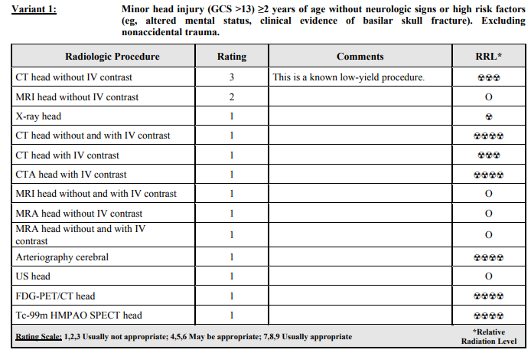
Alignment of Appropriateness Criteria and Choosing Wisely
All imaging variants and clinical scenarios: https://acsearch.acr.org/docs/3083021/Narrative
11
Notes:
An AC example for the specific R-SCAN topic will be in all templates.
Variants 4 and 5 located here: https://acsearch.acr.org/docs/3083021/Narrative

Slide 12
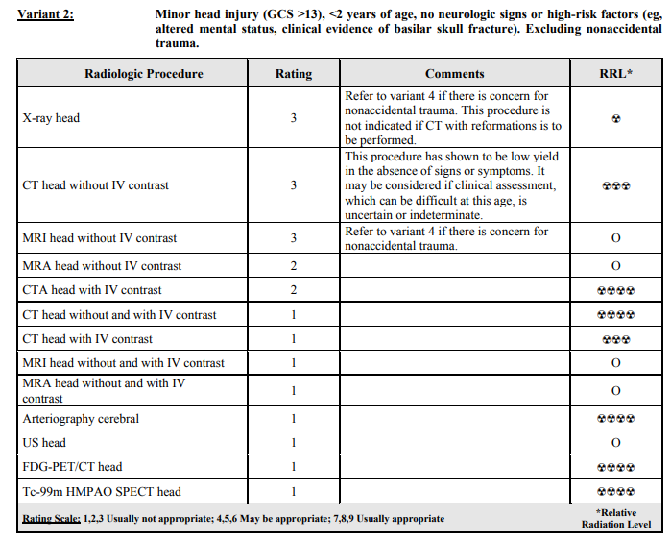
Alignment of Appropriateness Criteria and Choosing Wisely
All imaging variants and clinical scenarios: https://acsearch.acr.org/docs/3083021/Narrative
12
Notes:
An AC example for the specific R-SCAN topic will be in all templates.
Variants 4 and 5 located here: https://acsearch.acr.org/docs/3083021/Narrative

Slide 13
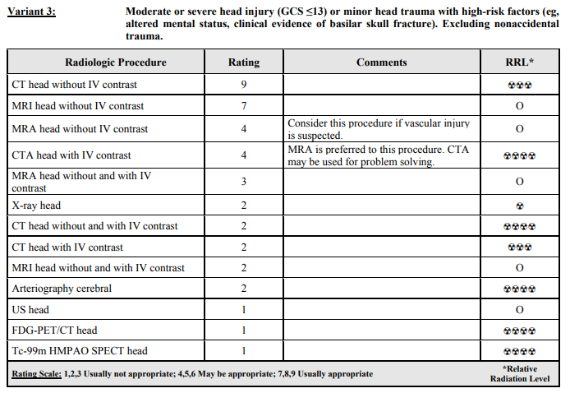
Alignment of Appropriateness Criteria and Choosing Wisely
All imaging variants and clinical scenarios: https://acsearch.acr.org/docs/3083021/Narrative
13
Notes:
An AC example for the specific R-SCAN topic will be in all templates.
Variants 4 and 5 located here: https://acsearch.acr.org/docs/3083021/Narrative

Slide 14
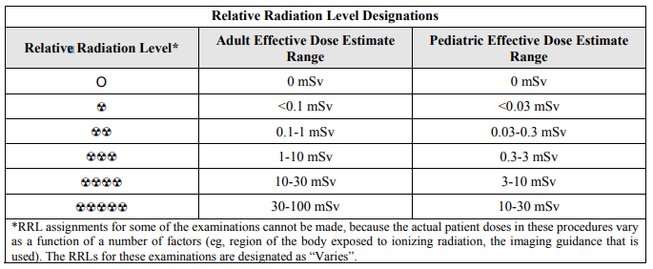
Relative Radiation Level Designations
Potential adverse health effects associated with radiation exposure are an important factor to consider when selecting the appropriate imaging procedure, or to use imaging at all, particularly in the pediatric population.
Notes:
Customized topic slide
Because there is a wide range of radiation exposures associated with different diagnostic procedures, a relative radiation level (RRL) indication has been included for each imaging examination. The RRLs are based on effective dose, which is a radiation dose quantity that is used to estimate population total radiation risk associated with an imaging procedure. Patients in the pediatric age group are at inherently higher risk from exposure, both because of organ sensitivity and longer life expectancy (relevant to the long latency that appears to accompany radiation exposure). For these reasons, the RRL dose estimate ranges for pediatric examinations are lower as compared to those specified for adults (see Table on slide).
Additional information regarding radiation dose assessment for imaging examinations can be found in the ACR Appropriateness Criteria® Radiation Dose Assessment Introduction document: https://www.acr.org/-/media/ACR/Files/Appropriateness-Criteria/RadiationDoseAssessmentIntro.pdf

Slide 15
Assessing the Need for a CT Scan
CT scans are not always necessary in the immediate evaluation of minor head injuries.
Assessing pediatric patients for traumatic brain injury (TBI), especially those under 2 years, based on clinical evaluations can be less reliable and imaging may be warranted, but this decision should consider the risks of radiation.
Clinical observation and Pediatric Emergency Care Applied Research Network (PECARN) criteria should be used to determine whether imaging is indicated.
Minor head injuries caused by accidental trauma >13 on the Glascow Coma Scale (GCS) absent high-risks factors do not require a CT scan.
Notes:
Customized topic slide

Slide 16
Assessing the Need for a CT Scan
If the patient exhibits any of the following, they are high risk and CT is indicated:
Signs of skull fracture
Altered mental status (AMS)
Suspected nonaccidental trauma
If the patient exhibits any of the following, they are moderate risk, and CT may be appropriate vs observation:
Vomiting
Loss of Consciousness (LOC)
Severe headache
Severe mechanism of injury
Scalp hematoma (excluding frontal)
Not acting normally per parent
Notes:
Customized topic slide
More information: https://www.uptodate.com/contents/minor-head-trauma-in-infants-and-children-evaluation#H89479938

Slide 17
Assessing the Need for a CT Scan
Clinical factors used to guide decision-making:
Multiple vs. isolated factors
Worsening findings during observation (AMS, headache, vomiting)
Physician experience
Parental preference
<3 months old
Notes:
Customized topic slide
Guidelines for neuroimaging vs observation: https://www.uptodate.com/contents/minor-head-trauma-in-infants-and-children-evaluation#H1237555

Slide 18
PECARN Clinical Prediction Rules for TBI
Prediction rule for traumatic brain injury - PECARN
Age <2 years | Age ≥2 years
Altered mental status† Severe mechanism of injury‡ Loss of consciousness ≥ 5 seconds Palpable skull fracture Non-frontal scalp hematoma Abnormal behavior | Altered mental status† Severe mechanism of injury‡ Any loss of consciousness Signs of basilar skull fracture History of vomiting Severe headache
Children with no clinical factors are classified as “low risk.” † GCS 14, agitation, sleepiness, slow response or repetitive questioning ‡ Motor vehicle crash with patient ejection, death or another passenger or “rollover”, pedestrian or cyclist without helmet struck by vehicle, fall ( >1m for children 1.5m for children ≥2 yrs), or head struck by “high-impact” object
Notes:
Customized topic slide
The PECARN Head Injury Prediction Rules were developed through the largest study ever done on pediatric head injury.
https://www.pecarn.org/documents/Kuppermann_2009_The-Lancet.pdf

Slide 19
Pediatric Head Trauma CT Decision Guide <2y
Notes:
Customized topic slide

Slide 20
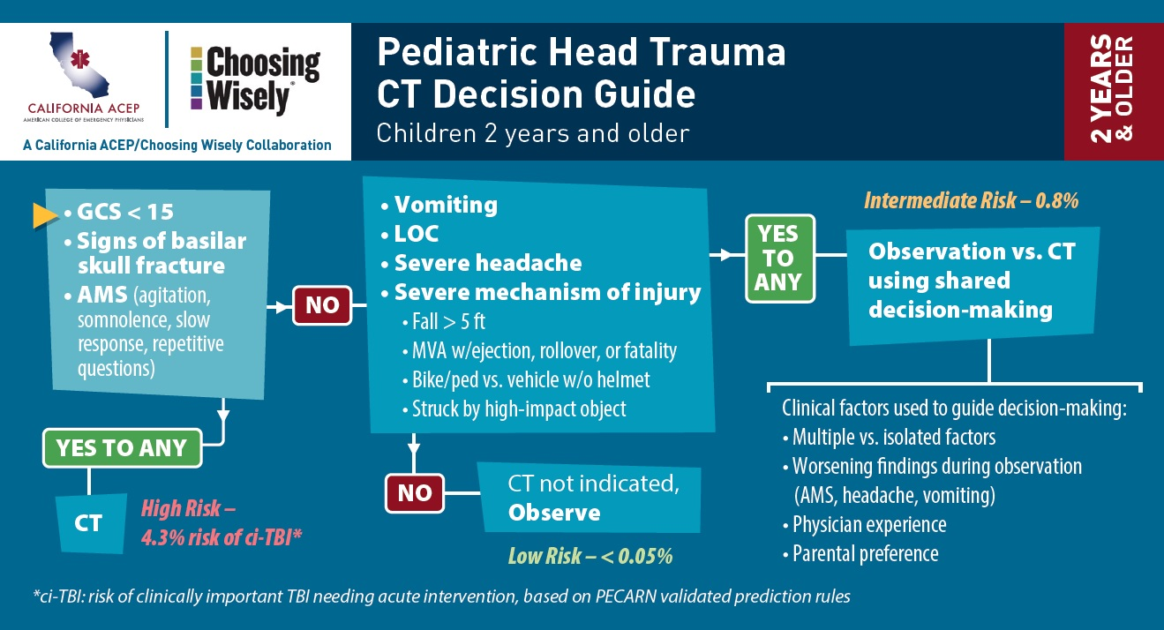
Pediatric Head Trauma CT Decision Guide ≥2y
Notes:
Customized topic slide

Slide 21
R-SCAN and Clinical Decision Support
CareSelect™ is a web-based version of the ACR Appropriateness Criteria, comprising over 3,000 clinical scenarios and 15,000 imaging indications
CareSelect provides evidence-based decision support for the appropriate utilization of medical imaging procedures
R-SCAN participants gain free access to a customized, web-based version of CareSelect, a helpful first step for aligning ordering patterns with appropriate use criteria
21
Notes:
Standard template
One of R-SCAN’s many free tools is the CareSelect CDS product, a digital version of the ACR AC. Specifically, the team uses CDS to rate the value of exams ordered for one of R-SCAN’s Choosing Wisely topics before and after an educational program is carried out.
All R-SCAN participants have free access to the web-based tool to explore the AC guidelines for other imaging topics. Consulting CDS will be a requirement for the ordering of advanced imaging for Medicare patients starting in 2019, so R-SCAN provides a good way to check out this technology.

Slide 22
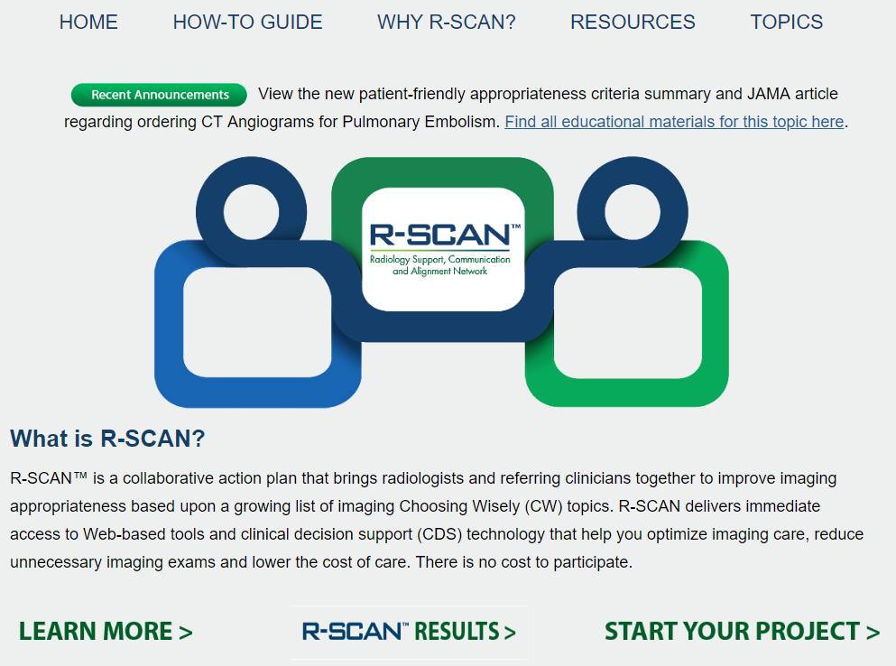
Getting Started
With
R-SCAN
rscan.org
22
Notes:
Standard template
To access ACR Select, visit the R-SCAN site and click on “Start your project.”

Slide 23
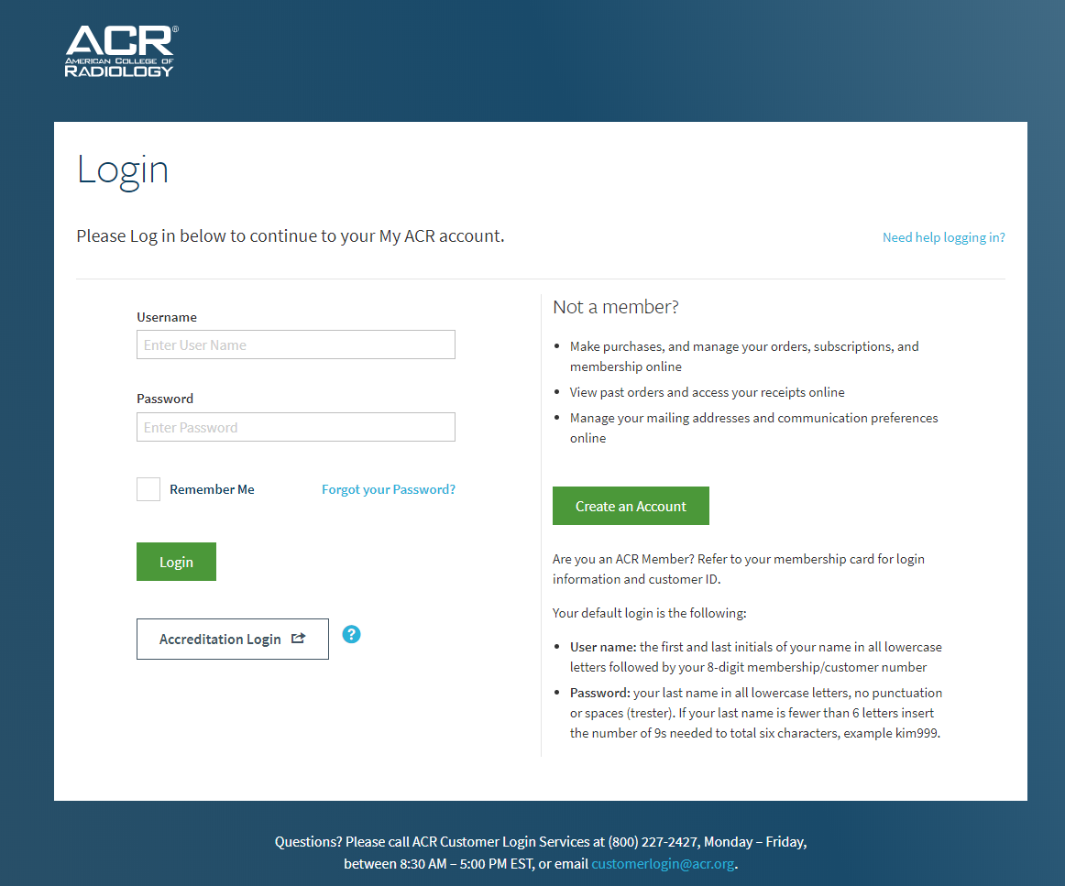
23
Notes:
Standard template
Log in with an ACR username/password. If you don’t have an ACR username and password, the R-SCAN team can provide one.

Slide 24
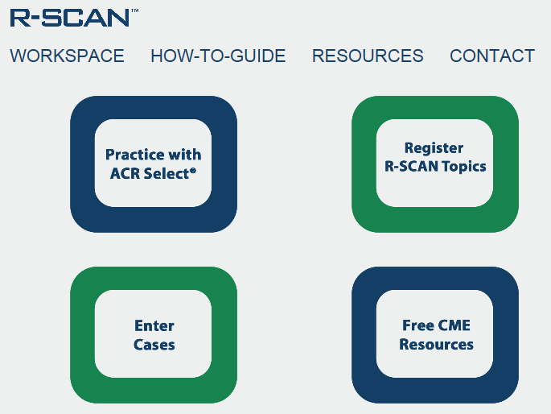
24
Notes:
Standard template
Click on “Practice with ACR Select.”

Slide 25
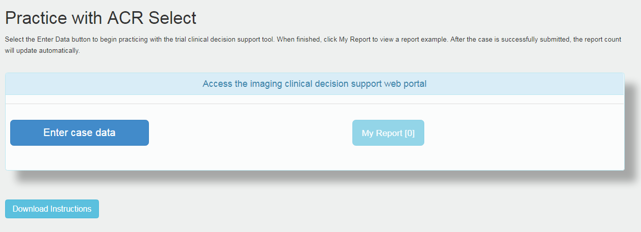
25
Notes:
Standard template
Check out the instructions for how to enter data and then click on the “Enter case data” button to explore the AC guidelines and exam ratings.

Slide 26
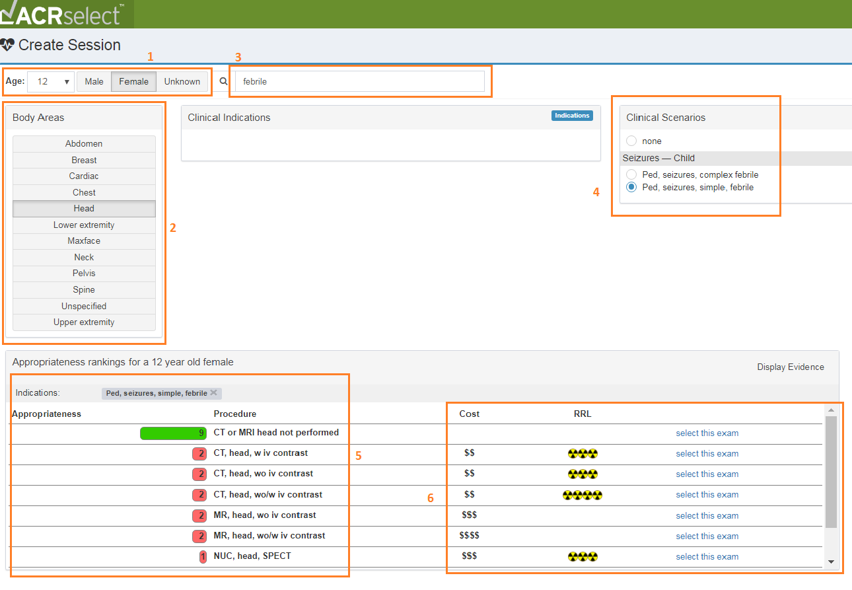
26
Notes:
Standard template
Here’s an example:
Enter a patient’s age and gender.
Select the body area of interest.
Search on a clinical indication.
Select the indication that’s the best match.
Review the appropriateness score and note the associated cost and radiation exposure.
Select the exam.

Slide 27
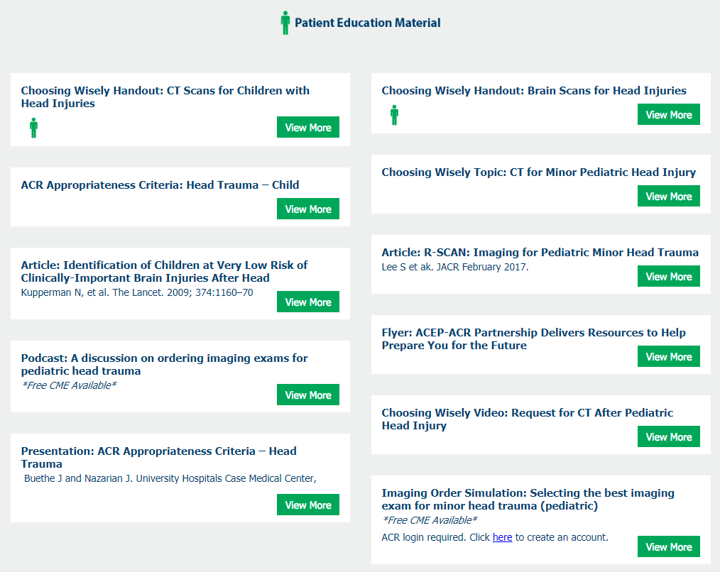
R-SCAN Minor Pediatric Head Injury Educational Resources
Visit: rscan.org
Click: Resources
Click: Topic-specific Resources
Podcast
Imaging Order Simulation activity
Articles
Materials to share with patients
27
Notes:
Standard template
A library of educational materials is available for each R-SCAN Choosing Wisely topic.

Slide 28
R-SCAN Resources With CME
Podcast
A radiologist and referring physician discuss strategies of CT image ordering for cases of minor pediatric head injury; approved for .5 CME
Learn more
Imaging Order Simulation Activity
Test your knowledge in selecting the best imaging exam for various indications
Free with CME
Notes:
Standard template

Slide 29
Key Points: Talking With Parents (1/2)
Here are talking points to explain to anxious patients why imaging is not necessary when TBI risk is low:
The evidence for deferring imaging in favor of clinical observation is robust for those at low or even moderate risk of clinically important traumatic brain injury.
Children are at a higher risk for cancer as a side effect of radiation from CT scans.
Unnecessary scans have a potential for false positives from incidental findings, which may lead to additional unnecessary imaging and treatment (more costs and/or radiation exposure).
A concussion does not warrant a CT scan; CT is better for other kinds of injuries, such as skull fractures or bleeding in the brain.
Notes:
Customized topic slide
When they’re needed, CT scans are very helpful. And the risk from a single scan is very small. But CT scans expose you to a strong dose of radiation. In some cases, it’s the same as having about 200 chest X-rays. Your body can often repair the damage CT scans cause to your tissue—but not always. And when it doesn’t, the damage could lead to cancer. The more times you’re exposed, the greater your risk of cancer. Children are more sensitive to ionizing radiation than adults and have a longer lifespan for complications to occur, thus there is a heightened concern for the effects of CT.
Other important notes when speaking to patients: http://www.choosingwisely.org/patient-resources/ct-scans-for-children-with-head-injuries/
Video example of speaking with a patient’s parent: http://modules.choosingwisely.org/modules/m_09/videos/m09_2_motherWantsCTafterFall.html

Slide 30
Key Points: Talking With Patients (2/2)
Here are talking points to explain to anxious patients why imaging is not necessary when TBI risk is low:
Certain costs associated with imaging are not covered by insurance, such as payments to meet deductible thresholds and co-pays.
The parent should continue to observe the child and go to the doctor if the child becomes unconscious, has a headache that won’t stop, or is dizzy, confused, or nauseous. These symptoms may happen hours or days later.
Notes:
Customized topic slide
Other important notes when speaking to patients: http://www.choosingwisely.org/patient-resources/ct-scans-for-children-with-head-injuries/
Video example of speaking with a patient’s parent: http://modules.choosingwisely.org/modules/m_09/videos/m09_2_motherWantsCTafterFall.html

Slide 31
Self-Assessment Question 1
Which of the following may necessitate CT in the case of a child under 2 years old?
Fall >3 ft
Crying
Bruising
Concussion
Notes:
Answer: A

Slide 32
Self-Assessment Question 2
Physical examination of a child with minor head injury should look for which of the following?
AMS
Scalp abnormalities
Signs of skull fracture
All of the above
Notes:
Answer: D

Slide 33
Case 1
A 7-year-old girl fell from a monkey bar apparatus, striking her head when she landed. There was no loss of consciousness or vomiting.
Questions:
What imaging would be most appropriate for this patient?
What other questions would you ask?
What is the focus of your physical exam?
Notes:
Each template will include a few case examples.
Answer: No imaging is recommended in children with head trauma with a Glasgow Coma Score (GCS) of >13 and without a loss of consciousness or an episode of vomiting.

Slide 34
Case 2
A 2-year-old girl is brought to the emergency room after falling from her bed. The girl is somnloment and difficult to wake.
Questions:
What imaging would be most appropriate for this patient?
What other questions would you ask?
What is the focus of your physical exam?
Notes:
Each template will include a few case examples.
Answer: CT imaging of the head without intravenous contrast is recommended to evaluate for trauma and potential child abuse in this patient with an abnormal neurologic exam and Glasgow Coma Score (GCS) <13. A noncontrast CT scan can rapidly assess for traumatic injury such as herniation or hemorrhage that may require prompt intervention.

Slide 35
Blank slide for radiologist to add custom info
Notes:
Suggested topics for additions
Becoming more familiar with pediatric patient care and what to look for
Case examples: https://www.acponline.org/clinical-information/high-value-care/resources-for-clinicians/high-value-care-pediatric-cases
How to speak with parents and take a patient- and family-centered approach

Slide 36
Blank slide for radiologist to add custom info
Notes:
Suggested topics for additions
Becoming more familiar with pediatric patient care and what to look for
Case examples: https://www.acponline.org/clinical-information/high-value-care/resources-for-clinicians/high-value-care-pediatric-cases
How to speak with parents and take a patient- and family-centered approach

Slide 37
Summary
Imaging is typically not indicated in children with minor head injury and no neurological signs or high risk factors.
Half of children sent to the ER with head injuries receive CT scans, but only one third of these identify abnormalities or require neurosurgical intervention.
The decision to image should consider the increased risks of ionizing radiation in children.
Providers should explain when imaging is necessary and the dangers of radiation to anxious parents of low risk patients.
Notes:
Standard template, but content will be customized

Slide 38
Summary
Clinical observation and Pediatric Emergency Care Applied Research Network (PECARN) criteria should be used to determine whether imaging is indicated.
Low risk—CT is not indicated: GCS >13 without neurological signs, AMS, or skull fracture
Moderate risk—CT may be indicated: GCS >13, vomiting, LOC, severe headache, severe mechanism of injury, scalp hematoma, abnormal behavior per parent
High risk—CT is indicated: GCS ≤13, AMS, or skull fracture
However, neurologic examination can be difficult in younger children and infants, and imaging in this setting may be appropriate if the clinical assessment is uncertain or indeterminate.
Notes:
Standard template, but content will be customized

Slide 39
Questions?

