Slide 1
CTA for Pulmonary Embolism
When to Image Based on Choosing Wisely® and ACR Appropriateness Criteria®
Notes:
Standard template

Slide 2
What Is R-SCAN?
Collaborative activity for referring clinicians and radiologists to improve patient care through clinical improvement
R-SCAN Collaboration Goals:
Ensure patients receive the most appropriate imaging exam at the most appropriate time based on evidence-based appropriate use criteria
Reduce unnecessary imaging tests focused on imaging Choosing Wisely® topics
Lower the cost of care
Notes:
Use this slide as a reminder / intro to what the program is about and its benefits.
Website is www.rscan.org.
For example, if your facility tends to order many CT exams for suspected pulmonary embolism, you might select that topic to ensure you’re ordering appropriately.
As far as a time commitment, staff time dedicated to an R-SCAN project ranges from 15 to 30 hours over a three- to six-month period.
You can also gain experience using a clinical decision support (CDS) tool; gaining experience with CDS now will help referring clinicians be prepared for the implementation of federal reimbursement requirements for CDS consultation prior to ordering advanced imaging. This alternative to pre-authorization reduces time and expense for practices and patients when imaging is the next step in the diagnostic process.

Slide 3
Why Participate?
R-SCAN Offers:
Data-driven system for moving toward value-based imaging and patient care
Opportunity to focus on highly relevant imaging exams to improve utilization
Collaborators can fulfill their Improvement Activity requirements under the MIPS
Easy way to practice with clinical decision support (CDS) technology
In preparation for PAMA
Free and immediate access to Web-based tools and CME activities
Notes:
Participants earn improvement activity credits.
More here: https://rscan.org/images/PDFs/RSCAN_Improvement-Flyer_v4.Web_09-11-17pdf.pdf
Information about Protecting Access to Medicare Act here: https://www.acr.org/Advocacy/eNews/20170421-Issue/20170421-ACR-Answers-Frequent-Questions-About-CDS-Mandate

Slide 4
Problem: Overutilization of CT Angiography for Pulmonary Embolism
The signs and symptoms of pulmonary embolism (PE) are non-specific, and the diagnosis can be missed clinically
It is estimated > 50% of cases of PE go undiagnosed and clinical concern has driven a substantial increase in the utilization of imaging, especially CT scanning[1].
According to Hess et al [2], the number of emergency department (ED) CT examinations increased from 41.1 per 1,000 in 2000 to 74.4 per 1,000 in 2010 (an 81% absolute increase).
Bruno, M.A., Mahraj, R.P.M., Whitener, C.J., DeFlitch, C.J., Beck, M.J., Geeting, G.K. An interdepartmental consensus statement on the optimal utilization of enhanced helical CT scanning of the chest for the diagnosis of pulmonary embolism (CT-PA) at Penn State Milton S. Hershey Medical Center. Penn State. 2014.
Hess, E.P., Haas, L.R., Shah, N.D., Stroebel, R.J., Denham, C.R., and Swensen, S.J. Trends in computed tomography utilization rates: a longitudinal practice-based study. J Patient Saf. 2014; 10: 52–58

Slide 5
Using Evidence to Guide Imaging Ordering
Choosing Wisely campaign
Collaborative effort between ABIM Foundation and over 70 medical specialty societies
Helps patients and medical professionals avoid wasteful or unnecessary medical tests, treatments and procedures
Many medical associations agree that there are situations when CTA is inappropriate for suspected pulmonary emboli, including:
American College of Emergency Physicians
Society of Nuclear Medicine and Molecular Imaging
American College of Radiology
Notes:
Choosing Wisely includes 150 patient-friendly resources and more than 500 specialty societies provided recommendations.
Learn more: www.choosingwisely.org

Slide 6
Using Evidence to Guide Imaging Ordering
ACR Appropriateness Criteria®
Assist referring physicians and other providers in making the most appropriate imaging or treatment decisions for specific clinical conditions
Employs input of physicians from other medical specialties and societies to provide important clinical perspectives
6
Notes:
See next slide for more info on the AC

Slide 7
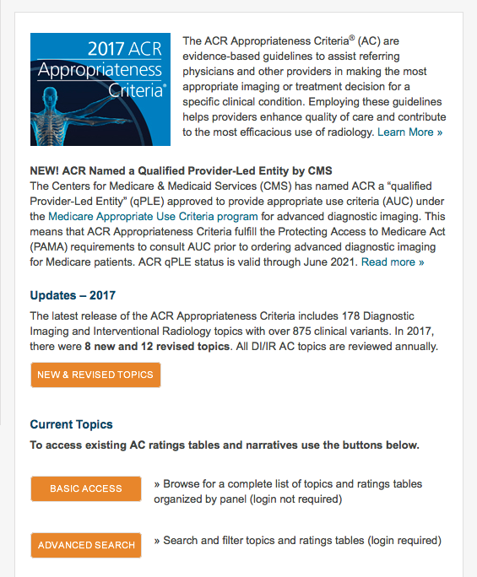
ACR Appropriateness Criteria: The Facts
178 clinical imaging topics
Over 875 clinical variants
Basic access is free
Learn more at acr.org/ac
7
Notes:
New Appropriateness Criteria topics are added annually.

Slide 8
Appropriateness Criteria Rating by Value
8
Notes:
Exams associated with imaging for the individual clinical indications are rated according to their value as determined by the members of the Appropriateness Criteria panels. The panels use the following approach for determining the exams rating, or value:
1. The guideline authors conduct a systematic search of scientific literature, identify most relevant articles and develop initial ratings.
2. A larger panel reviews and carries out rating rounds.
3. Topics updated every 3 years, or more frequently where needed.

Slide 9
ACR Appropriateness Criteria for Suspected Pulmonary Embolism
Variant 1:
Suspected pulmonary embolism. Intermediate probability with a negative D-dimer or low pretest probability.
Variant 2:
Suspected pulmonary embolism. Intermediate probability with a positive D-dimer or high pretest probability.
Variant 3:
Suspected pulmonary embolism. Pregnant patient.
9
Notes:
The major clinical indications – or “variants” are considered for each Appropriateness Criteria topic.

Slide 10
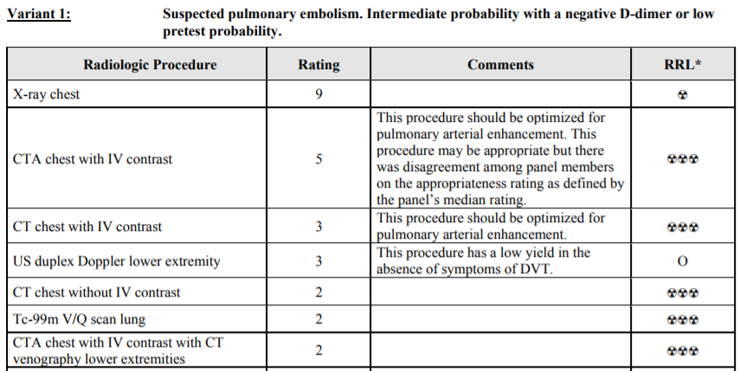
Alignment of Appropriateness Criteria and Choosing Wisely
All CTA for PE imaging variants and clinical scenarios: https://acsearch.acr.org/docs/69404/Narrative/
10
Notes:
An AC example for CTA for PE
https://acsearch.acr.org/docs/69483/Narrative/

Slide 11
When to Use CTA for Pulmonary Embolism
In the case of suspected PE with intermediate probability and a positive D-dimer or high pretest probability.
Appropriateness rating: 9
In pregnant patients in the case of a suspected pulmonary embolism.
Appropriateness rating: 7
The procedure should be optimized for pulmonary circulation.

Slide 12
Use of the D-Dimer Assay
A negative D-dimer effectively excludes PE or DVT
Limited value in the following situations:
Patients with a significant thrombotic process or condition
Pregnant, postoperative, trauma patients
Patients determined to be at high risk of PE by validated clinical criteria
Wells' Criteria
Geneva Score / Simplified Geneva Score
PERC Rule

Slide 13
Chest Radiography for Suspected PE
Can eliminate the need for additional studies by revealing an alternate reason for acute symptoms
Pneumonia, pleural effusion, acute heart failure
Normal chest x-ray does not exclude PE, and no x-ray findings are sufficient to confirm PE
Recent chest x-ray (<24 hours) is required for accurate interpretation of ventilation/perfusion studies

Slide 14
R-SCAN and Clinical Decision Support
The ACR Select® CDS tool is a web-based version ACR Appropriateness Criteria
R-SCAN participants gain free access to a customized, stand-alone version of ACR Select
Available through a web portal
No IT involvement required
R-SCAN uses CDS in a novel way
For case review to determine alignment with the ACR AC
14
Notes:
One of R-SCAN’s many free tools is the ACR Select CDS product, a digital version of the ACR Appropriateness Criteria
Specifically, the team uses CDS to rate the value of exams ordered for one of R-SCAN’s Choosing Wisely topics before and after an educational program is carried out.
All R-SCAN participants have free access to the web-based tool to explore the Appropriateness Criteria guidelines for other imaging topics.
Consulting clinical decision support will be a requirement for the ordering of advanced imaging for Medicare patients starting in 2019, so R-SCAN provides a good way to check out this technology.

Slide 15
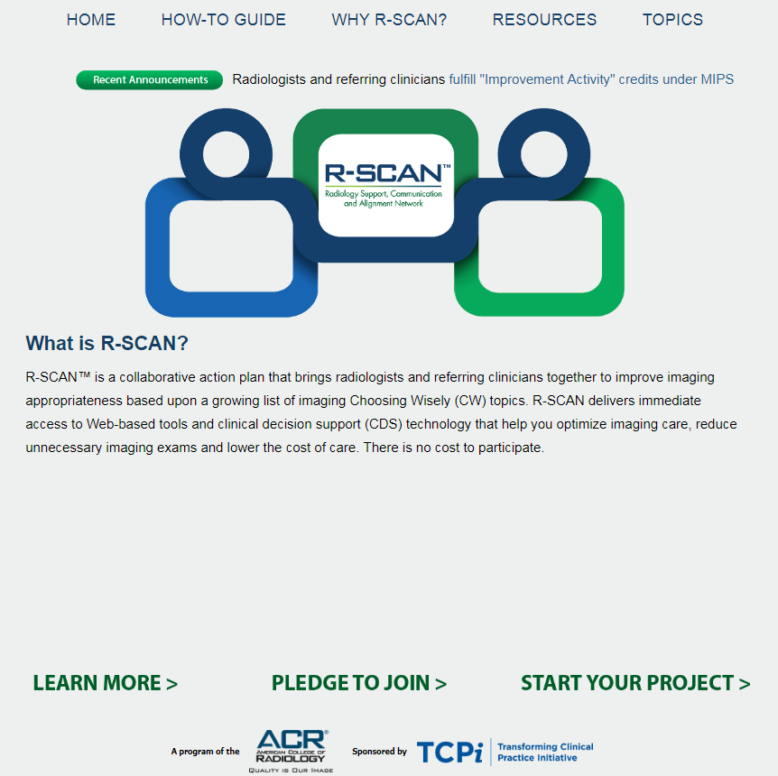
Getting Started
With
R-SCAN
rscan.org
15
Notes:
To access ACR Select, visit the RSCAN site and click on “Start your project”

Slide 16
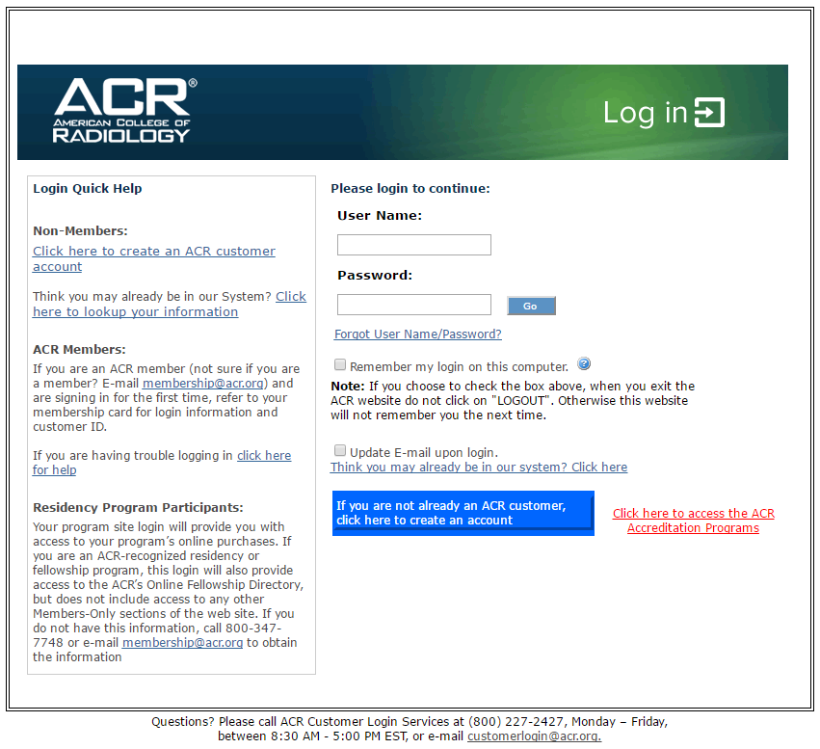
16
Notes:
Log in with an ACR username/password
If you don’t have an ACR username and password, the R-SCAN team can provide one.

Slide 17
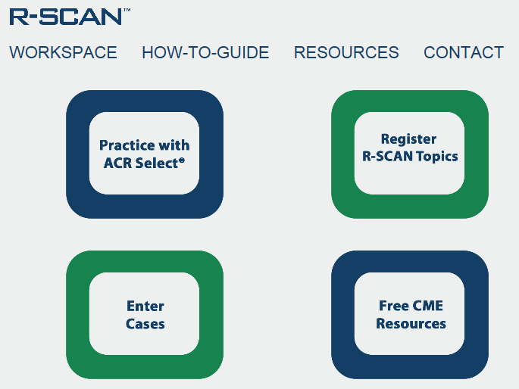
17
Notes:
Click on “Practice with ACR Select”

Slide 18
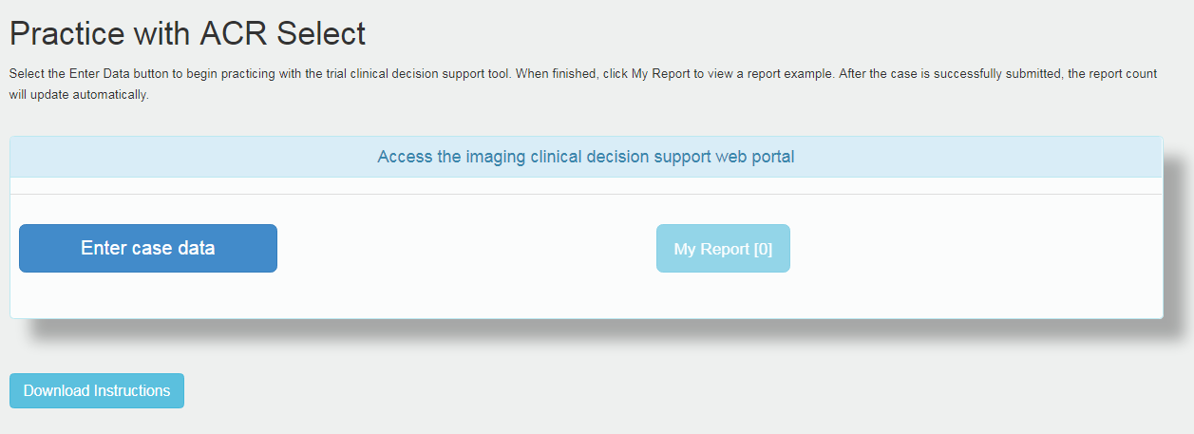
18
Notes:
Check out the instructions for how to enter data and then click on the “Enter case data” button to explore the AC guidelines and exam ratings.

Slide 19
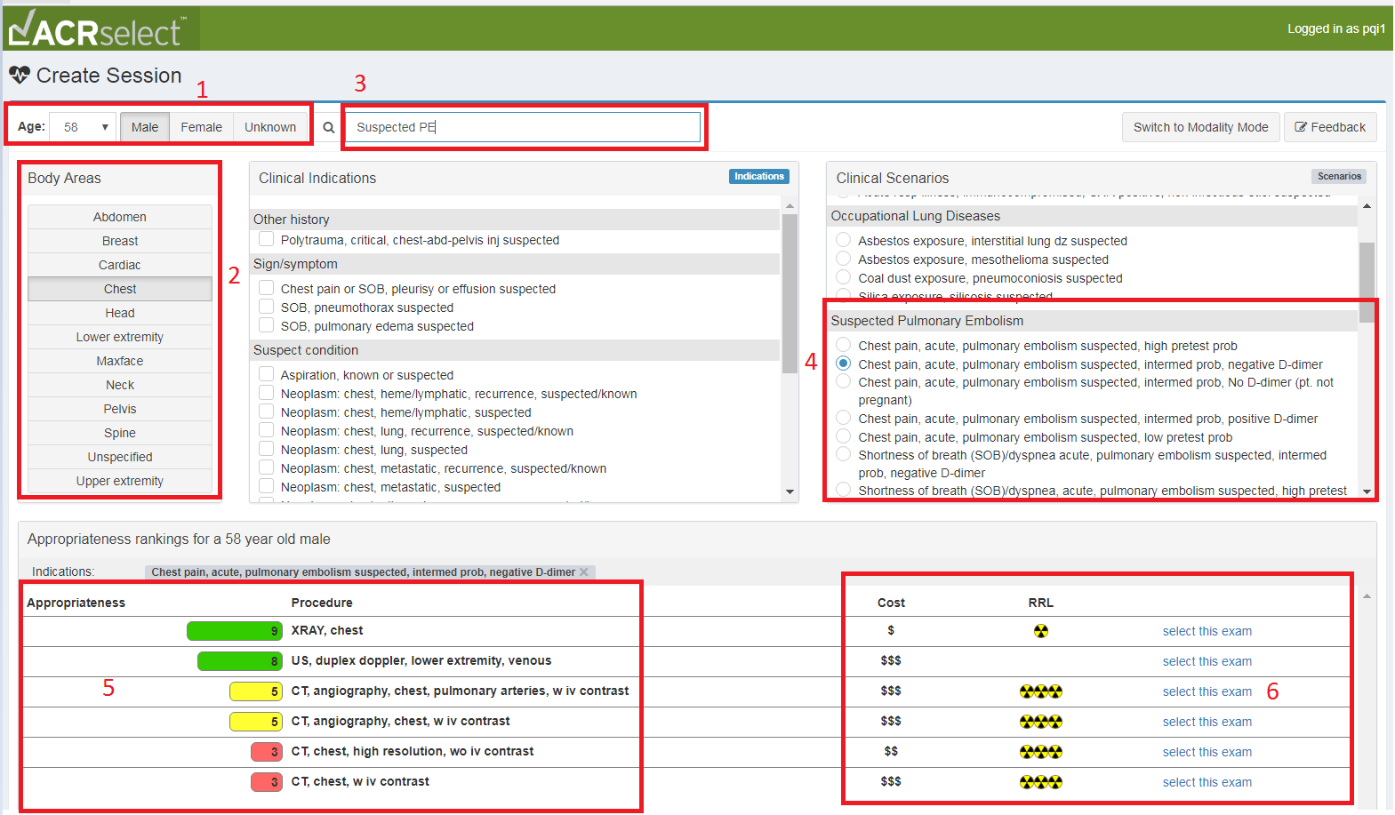
19
Notes:
Here’s an example:
Enter a patient’s age and gender
Select the body area of interest
Search on a clinical indication
Select the indication that’s the best match
Review the appropriateness score and note the associated cost and radiation exposure
Select the exam.

Slide 20
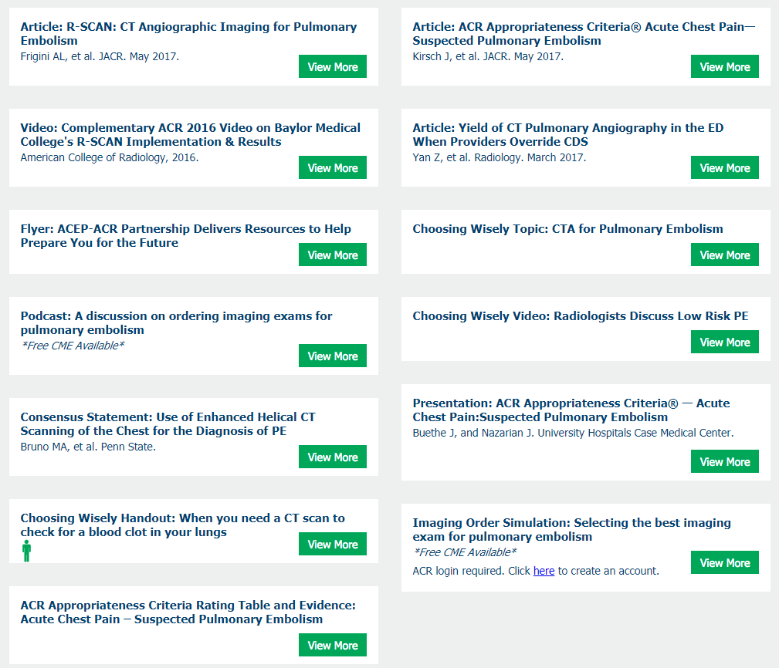
R-SCAN CTA for PE Educational Resources
Visit: rscan.org
Click: Resources
Click: Topic-specific Resources
Podcasts
Imaging Order Simulation activity
Articles
Materials to share with patients
20
Notes:
Note: A library of educational materials is available for each R-SCAN Choosing Wisely topic.

Slide 21
R-SCAN Resources With CME
Podcast
A radiologist and referring physician discuss strategies of image ordering related suspected pulmonary embolism; approved for .5 CME
Learn more
Imaging Order Simulation Activity
Test your knowledge in selecting the best imaging exam for various indications
Free with CME

Slide 22
Key Points: Talking With Patients
Choosing Wisely: CT Imaging Concerns
Imaging won’t help you feel better or improve faster
Imaging is expensive, costing hundreds or thousands of dollars
Imaging can also lead to unnecessary treatments and complications from these treatments
X-rays and CT scans use radiation
Notes:
The danger of too many CT scans When they’re needed, CT scans are very helpful. And the risk from a single scan is very small. But CT scans expose you to a strong dose of radiation. In some cases, it’s the same as having about 200 chest X-rays. Your body can often repair the damage CT scans cause to your tissue—but not always. And when it doesn’t, the damage could lead to cancer. The more times you’re exposed, the greater your risk of cancer
Other important notes when speaking to patients: https://rscan.org/images/PDFs/topic_resources/ChoosingWiselyEmbolismACEP-ER.pdf

Slide 23
Case 1
A 26-year-old man presents with shortness of breath
No clinical signs of deep vein thrombosis (DVT), and pulmonary embolism (PE) is not the most likely diagnosis
Heart rate is 105
Hemoptysis is not seen and no history of surgery, PE, DVT, or malignancy
The modified Wells criteria is 1.5, pulmonary embolus could not be excluded based on the PERC Rule
The D-dimer is negative.
Questions:
What imaging would be most appropriate for this patient?
What other questions would you ask?
What is the focus of your physical exam?

Slide 24
Case 2
A 65-year-old woman presents with shortness of breath and chest pain.
No history of pulmonary embolism (PE) or deep vein thrombosis (DVT)
Heart rate is 105.
Patient underwent recent surgery for breast cancer and has asymmetric lower extremity edema
Congestive heart failure and PE are equally suspected
No hemoptysis is seen and the modified Wells criteria score is 7.
Questions:
What imaging would be most appropriate for this patient?
What other questions would you ask?
What is the focus of your physical exam?

Slide 25
Summary
Diagnostic efforts in radiology are aimed at (1) reaching an acceptable level of diagnostic certainty of PE to warrant anticoagulant therapy, using the least invasive tests, and (2) excluding other reasons for the patient’s symptoms.
D-dimer levels will be elevated with any significant thrombotic process, so this test is of limited value in pregnant, postoperative, and trauma patients.
D-dimer is also of limited value in patients determined to be at high risk of PE by validated clinical criteria.
In all other settings, a negative D-dimer test effectively excludes PE or DVT
Notes:
Standard template, but content will be customized

Slide 26
Blank slide for radiologist to add custom info

Slide 27
Blank slide for radiologist to add custom info

Slide 28
Questions?

