Slide 1
CT for Adult Minor Head Trauma
When to Image Based on Choosing Wisely® and ACR Appropriateness Criteria®
Notes:
Standard template

Slide 2
What Is R-SCAN?
Collaborative activity for referring clinicians and radiologists to improve patient care through clinical improvement
R-SCAN Collaboration Goals:
Ensure patients receive the most appropriate imaging exam at the most appropriate time based on evidence-based appropriate use criteria
Reduce unnecessary imaging tests focused on imaging Choosing Wisely® topics
Lower the cost of care
Notes:
Standard template
Intro to what the program is about and its benefits.
Website is www.rscan.org
Time commitment: staff time dedicated to an R-SCAN project ranges from 15 to 30 hours over a three- to six-month period.
You can also gain experience using a clinical decision support (CDS) tool; gaining experience with CDS now will help referring clinicians be prepared for the implementation of federal reimbursement requirements for CDS consultation prior to ordering advanced imaging. This alternative to pre-authorization reduces time and expense for practices and patients when imaging is the next step in the diagnostic process.

Slide 3
Why Participate?
R-SCAN Offers:
Data-driven system for moving toward value-based imaging and patient care
Opportunity to focus on highly relevant imaging exams to improve utilization
Collaborators can fulfill their Improvement Activity requirements under the MIPS
Easy way to practice with clinical decision support (CDS) technology
In preparation for PAMA
Free and immediate access to Web-based tools and CME activities
Notes:
Standard template
Participants earn improvement activity credits.
More here: https://rscan.org/images/PDFs/RSCAN_Improvement-Flyer_v4.Web_09-11-17pdf.pdf
Information about Protecting Access to Medicare Act here: https://www.acr.org/Advocacy-and-Economics/Advocacy-News/Advocacy-News-Issues/In-the-April-21-2017-Issue/ACR-Answers-Frequent-Questions-About-CDS-Mandate

Slide 4
Problem: Overutilization of CT Imaging for Adult Minor Head Trauma
Each year, physicians in Canadian and US emergency departments (EDs) treat more than 8 million patients with head injury, representing approximately 6.7% of the 120 million total ED visits [1].
Use of CT for minor head injury has increased rapidly. Between 1992 and 2000, use of CT imaging for all conditions in US emergency departments has increased from 2.4% to 5.3% of all visits, a 120% increase [1]. However, 90% of CTs are negative for clinically important brain injury [2].
As CT scans expose patients to ionizing radiation, increasing patients’ lifetime risk of cancer, they should only be performed on patients at risk for significant injuries. CT scans also present significant cost to the health care system.
Notes:
The problem statement
More information on the issue here:
https://jamanetwork.com/journals/jama/fullarticle/201596
https://www.ncbi.nlm.nih.gov/pubmed/11356436
https://www.jacr.org/article/S1546-1440(16)30808-0/fulltext
References:
McCaig LF, Ly N. National Hospital Ambulatory Medical Care Survey: 2000 emergency department summary. Adv Data. 2002;(327):1-27.
Stiell IG, Wells GA, Vandemheen K. et al. The Canadian CT Head Rule for patients with minor head injury. Lancet. 2001;357(9266):1391-1396.

Slide 5
Using Evidence to Guide Imaging Ordering
Choosing Wisely campaign
Collaborative effort between ABIM Foundation and over 70 medical specialty societies
Helps patients and medical professionals avoid wasteful or unnecessary medical tests, treatments, and procedures
Many medical associations agree that CT scans are not necessary in the immediate evaluation of pediatric minor head injuries, including:
American College of Emergency Physicians
American Medical Society for Sports Medicine
Notes:
Standard template
Choosing Wisely includes 150 patient-friendly resources and more than 500 specialty society provided recommendations.
Learn more: www.choosingwisely.org

Slide 6
Using Evidence to Guide Imaging Ordering
ACR Appropriateness Criteria®
Assist referring physicians and other providers in making the most appropriate imaging or treatment decisions for specific clinical conditions
Employs input of physicians from other medical specialties and societies to provide important clinical perspectives
6
Notes:
Standard template
See next slide for more info on the Appropriateness Criteria (AC).

Slide 7
ACR Appropriateness Criteria: The Facts
178 clinical imaging topics and over 875 clinical variants
Basic access is free
Learn more at acr.org/ac
7
Notes:
Standard template
New AC topics are added annually.

Slide 8
ACR Appropriateness Criteria for Head Trauma (1/2)
Variant 1: Minor or mild acute closed head injury (GCS ≥13), imaging not indicated by NOC or CCHR or NEXUS-II clinical criteria (see Appendix 1). Initial study.
Variant 2: Minor or mild acute closed head injury (GCS ≥13), imaging indicated by NOC or CCHR or NEXUS-II clinical criteria (see Appendix 1). Initial study.
Variant 3: Moderate or severe acute closed head injury (GCS <13). Initial study.
Variant 4: Short-term follow-up imaging of acute traumatic brain injury. No neurologic deterioration.
8
Notes:
The AC variants for the specific R-SCAN topic will be in all templates.
The major clinical indications – or “variants” – are considered for each AC topic. Explain how AC works and what the variants are.

Slide 9
ACR Appropriateness Criteria for Head Trauma (2/2)
Variant 5: Short-term follow-up imaging of acute traumatic brain injury. Neurologic deterioration, delayed recovery, or persistent unexplained deficits.
Variant 6: Subacute or chronic traumatic brain injury with new cognitive and/or neurologic deficit(s).
Variant 7: Suspected intracranial arterial injury.
Variant 8: Suspected intracranial venous injury.
Variant 9: Suspected post-traumatic cerebrospinal fluid (CSF) leak.
9
Notes:
The AC variants for the specific R-SCAN topic will be in all templates.
The major clinical indications – or “variants” – are considered for each AC topic. Explain how AC works and what the variants are.

Slide 10
Appropriateness Criteria Rating by Value
10
Notes:
Standard template
Exams associated with imaging for the individual clinical indications are rated according to their value as determined by the members of the AC panels. The panels use the following approach for determining the exam’s rating, or value:
The guideline authors conduct a systematic search of scientific literature, identify most relevant articles, and develop initial ratings.
A larger panel reviews and carries out rating rounds.
Topics updated every 3 years or more frequently where needed.

Slide 11
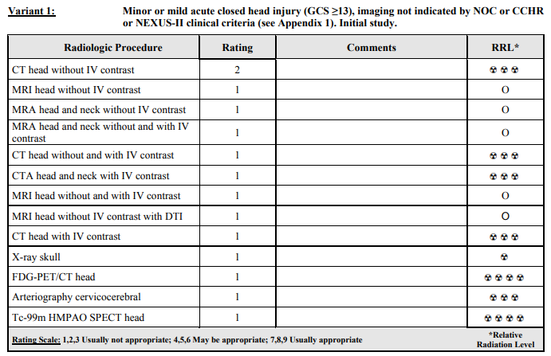
Alignment of Appropriateness Criteria and Choosing Wisely
All imaging variants and clinical scenarios: https://acsearch.acr.org/docs/69481/Narrative/
11
Notes:
An AC example for the specific R-SCAN topic will be in all templates.
Variants 5-9 located here: https://acsearch.acr.org/docs/69481/Narrative/

Slide 12
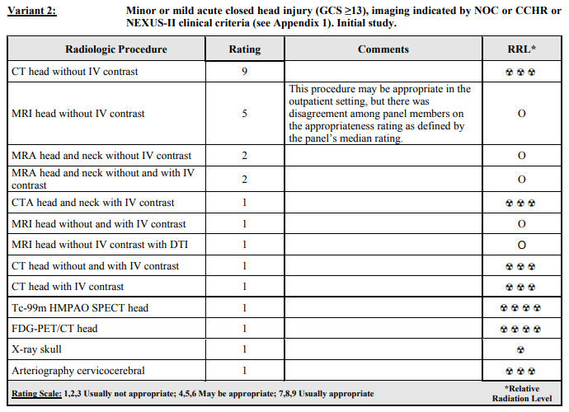
Alignment of Appropriateness Criteria and Choosing Wisely
All imaging variants and clinical scenarios: https://acsearch.acr.org/docs/69481/Narrative/
12
Notes:
An AC example for the specific R-SCAN topic will be in all templates.
Variants 5-9 located here: https://acsearch.acr.org/docs/69481/Narrative/

Slide 13
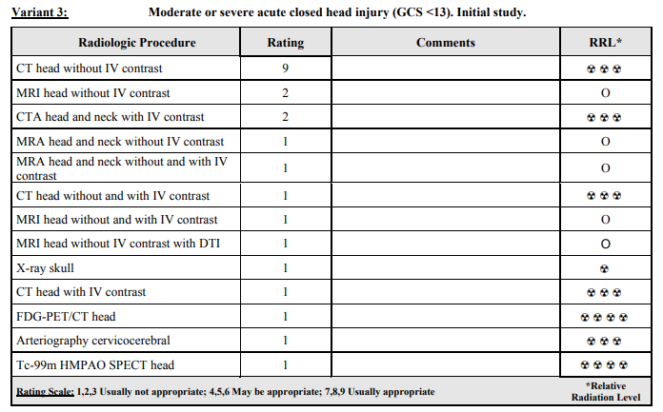
Alignment of Appropriateness Criteria and Choosing Wisely
All imaging variants and clinical scenarios: https://acsearch.acr.org/docs/69481/Narrative/
13
Notes:
An AC example for the specific R-SCAN topic will be in all templates.
Variants 5-9 located here: https://acsearch.acr.org/docs/69481/Narrative/

Slide 14
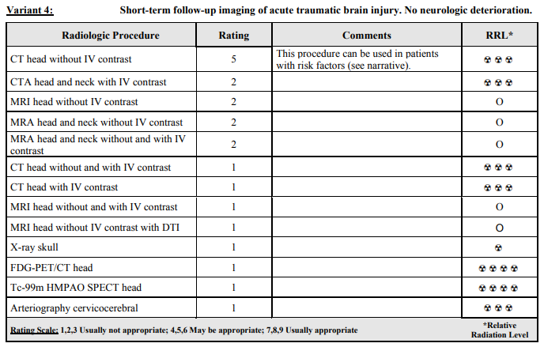
Alignment of Appropriateness Criteria and Choosing Wisely
All imaging variants and clinical scenarios: https://acsearch.acr.org/docs/69481/Narrative/
14
Notes:
An AC example for the specific R-SCAN topic will be in all templates.
Variants 5-9 located here: https://acsearch.acr.org/docs/69481/Narrative/

Slide 15
Assessing the Need for a CT Scan
Multiple studies have suggested that clinical decision rules may be helpful in identifying patients with minor head injury (GCS 13-15) who do not need CT.
Canadian CT Head Rule (CCHR)
New Orleans Criteria (NOC)
NEXUS-II
ACEP Clinical Policy
Minor or mild acute closed head injuries ≥13 on the Glascow Coma Scale (GCS) when imaging is not indicted by clinical criteria do not require a CT scan.
For patients with minor or mild acute closed head injuries who meet clinical criteria for imaging, noncontrast CT is the most appropriate initial imaging study.
Notes:
Customized topic slide
More information on clinical decision rules is located here:
CCHR: https://www.ncbi.nlm.nih.gov/pubmed/11356436
NOC: https://www.nejm.org/doi/full/10.1056/NEJM200007133430204
NEXUS-II: https://www.sciencedirect.com/science/article/pii/S0196064402001440
ACEP: https://www.acep.org/WorkArea/DownloadAsset.aspx?id=108913

Slide 16
Canadian CT Head Rules
Developed from a large, prospective cohort study conducted in 10 Canadian hospitals with 3121 patients
High-risk factors were 100% sensitive for predicting need for neurosurgical intervention
Evidence indicates this rule may be more specific with regard to clinical outcomes than the New Orleans Criteria.
https://jamanetwork.com/journals/jama/fullarticle/201596
https://jamanetwork.com/journals/jama/fullarticle/201595
Notes:
Customized topic slide

Slide 17
Canadian CT Head Rules (CCHR)
For patients with GCS 13-15 after witnessed traumatic loss of consciousness, CT is only required for patients with any of the following findings:
High risk for neurological intervention | Medium risk for brain injury detection by CT imaging
GCS <15 at two hours after injury Suspected open or depressed skull fracture Any sign of basal skull fracture† Two or more episodes of vomiting ≥65 years of age | Amnesia before impact ≥30 minutes Dangerous mechanism‡
Exclusion criteria: no history of trauma, GCS <13, age <16 years, warfarin use or coagulopathy, obvious open skull fracture, acute focal neurologic deficit, unstable vital signs, seizure, pregnancy † Hemotympanum, raccoon eyes, cerebrospinal fluid otorrhea or rhinorrhea, and Battle’s sign. ‡ A pedestrian struck by motor vehicle, an occupant ejected from a motor vehicle, or a fall from an elevation of >3 feet or 5 stairs.
Notes:
Customized topic slide

Slide 18
New Orleans Criteria (NOC)
Developed based on clinical findings in a series of 520 patients
Prospectively validated in a group of 909 patients
Sensitivity of the 7 findings that make up the criteria combined was 100%. All patients with positive CT scans had at least one of the findings.
Notes:
Customized topic slide

Slide 19
New Orleans Criteria (NOC)
Inclusion criteria:
GCS 15
Age >18 years
Blunt head trauma occurring within 24 hours and causing loss of consciousness, amnesia, or disorientation
CT only if one or more findings are present:
Headache
Vomiting
Age >60 years
Alcohol or drug intoxication
Deficits in short-term memory
Visible trauma above clavicles
Seizure
Notes:
Customized topic slide

Slide 20
National Emergency X-Radiography Utilization Study II (NEXUS II)
CT only if one or more findings are present:
Age ≥65 years
Evidence of significant skull fracture
Scalp hematoma
Neurologic deficit
Altered level of alertness
Abnormal behavior
Coagulopathy
Recurrent or forceful vomiting
Notes:
Customized topic slide

Slide 21
ACEP Clinical Policy
Level A: CT is indicated in patients with LOC or amnesia and ≥ 1 of the following:
Headache, vomiting, age greater than 60 years, drug or alcohol intoxication, deficits in short-term memory, physical evidence of trauma above the clavicle, posttraumatic seizure, GCS score less than 15, focal neurologic deficit, or coagulopathy.
Level B: CT should be considered in patients with no LOC or amnesia and ≥ 1 of the following:
Focal neurologic deficit, vomiting, severe headache, age 65 years or greater, physical signs of a basilar skull fracture, GCS score less than 15, coagulopathy, or a dangerous mechanism of injury.*
Notes:
Customized topic slide
*Dangerous mechanism of injury includes ejection from a motor vehicle, a pedestrian struck, and a fall from a height of more than 3 feet or 5 stairs.

Slide 22
Assessing Need for CT in Short-term Follow Up
The value of repeat noncontrast head CT in patients with an abnormal initial head CT and a stable neurologic examination is low, but CT scan may be warranted if the patient:
Has subfrontal/temporal intraparenchymal contusions
Is anticoagulated
Is >65 years of age
Has an intracranial hemorrhage with a volume of >10 mL
Notes:
Customized topic slide

Slide 23
R-SCAN and Clinical Decision Support
CareSelect™ is a web-based version of the ACR Appropriateness Criteria, comprising over 3,000 clinical scenarios and 15,000 imaging indications
CareSelect provides evidence-based decision support for the appropriate utilization of medical imaging procedures
R-SCAN participants gain free access to a customized, web-based version of CareSelect, a helpful first step for aligning ordering patterns with appropriate use criteria
23
Notes:
Standard template
One of R-SCAN’s many free tools is the CareSelect CDS product, a digital version of the ACR AC. Specifically, the team uses CDS to rate the value of exams ordered for one of R-SCAN’s Choosing Wisely topics before and after an educational program is carried out.
All R-SCAN participants have free access to the web-based tool to explore the AC guidelines for other imaging topics. Consulting CDS will be a requirement for the ordering of advanced imaging for Medicare patients starting in 2019, so R-SCAN provides a good way to check out this technology.

Slide 24
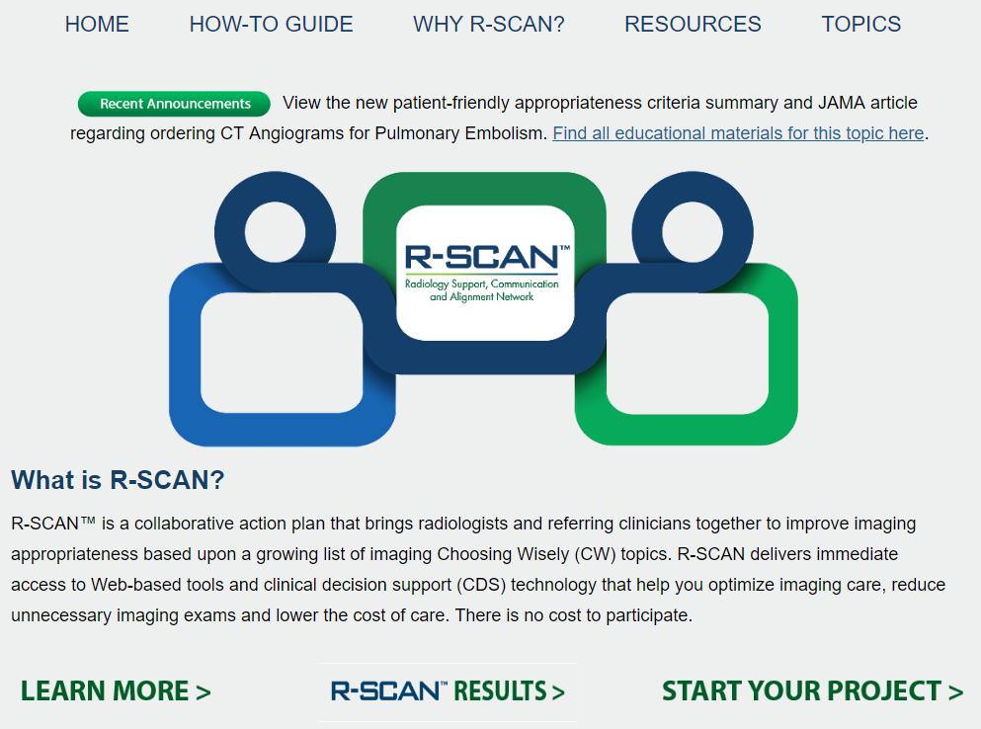
Getting Started
With
R-SCAN
rscan.org
24
Notes:
Standard template
To access ACR Select, visit the R-SCAN site and click on “Start your project.”

Slide 25
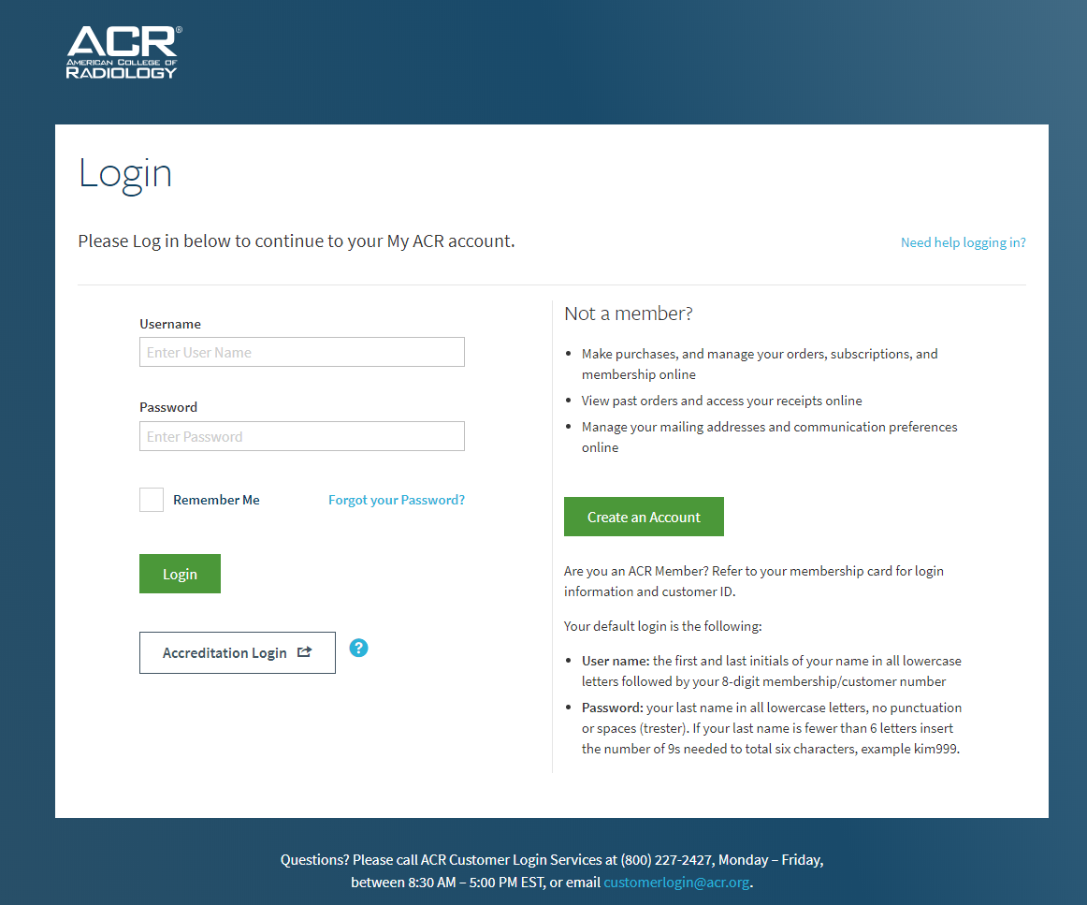
25
Notes:
Standard template
Log in with an ACR username/password. If you don’t have an ACR username and password, the R-SCAN team can provide one.

Slide 26
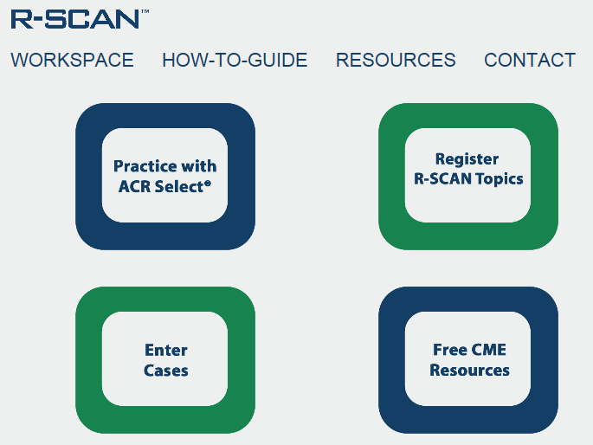
26
Notes:
Standard template
Click on “Practice with ACR Select.”

Slide 27
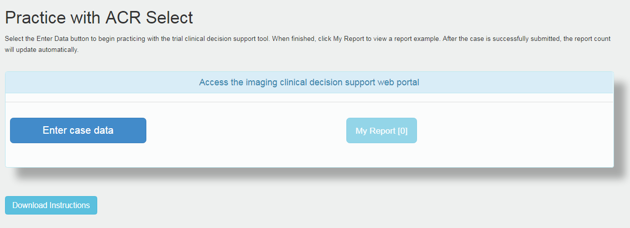
27
Notes:
Standard template
Check out the instructions for how to enter data and then click on the “Enter case data” button to explore the AC guidelines and exam ratings.

Slide 28
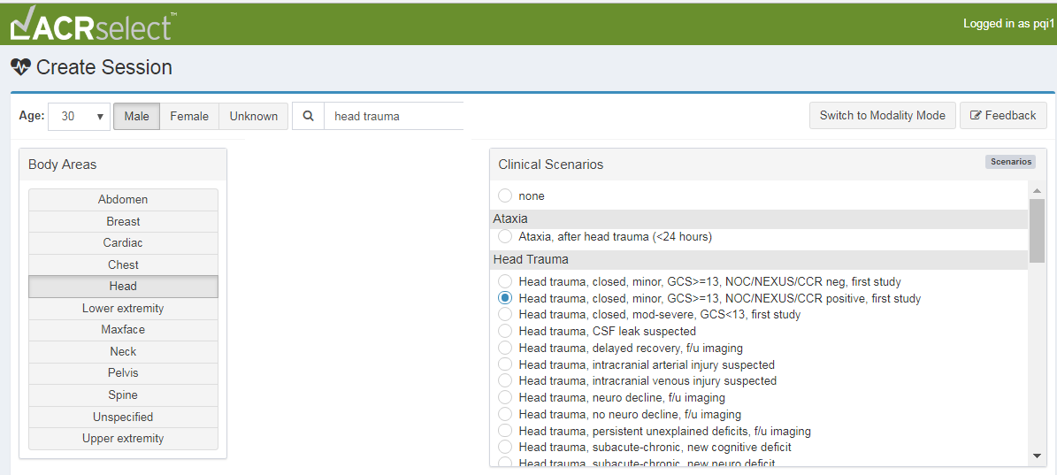
1
3
2
4
5
6
28
Notes:
Standard template
Here’s an example:
Enter a patient’s age and gender.
Select the body area of interest.
Search on a clinical indication.
Select the indication that’s the best match.
Review the appropriateness score and note the associated cost and radiation exposure.
Select the exam.

Slide 29
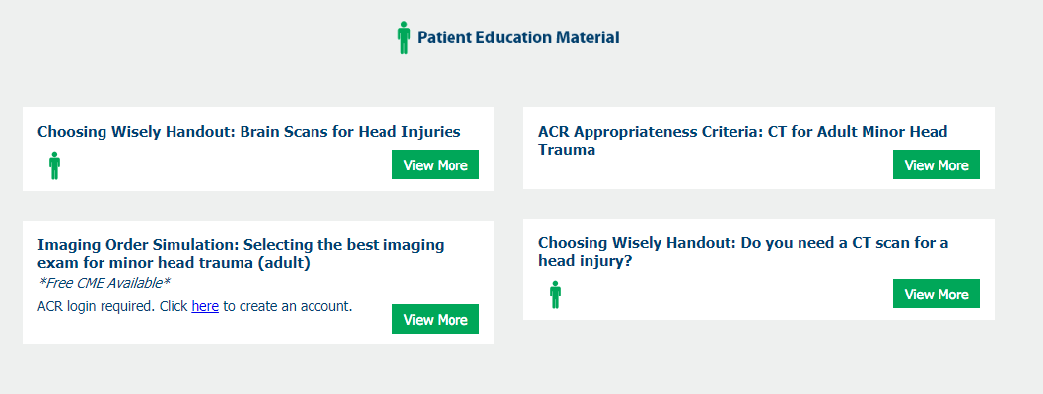
R-SCAN Minor Pediatric Head Injury Educational Resources
Visit: rscan.org
Click: Resources
Click: Topic-specific Resources
Podcast
Imaging Order Simulation activity
Articles
Materials to share with patients
29
Notes:
Standard template
A library of educational materials is available for each R-SCAN Choosing Wisely topic.

Slide 30
R-SCAN Resources With CME
Imaging Order Simulation Activity
Test your knowledge in selecting the best imaging exam for various indications
Free with CME
Notes:
Standard template

Slide 31
Key Points: Talking With Patients
Here are talking points to explain to patients why imaging is not necessary when TBI risk is low:
The evidence is robust for deferring imaging when clinical criteria are not met. If the patient isn’t exhibiting these high risk symptoms, it is very unlikely they have a clinically important brain injury.
CT scans expose you to a strong dose of radiation, which can increase your risk for cancer. In some cases, it’s the same as having about 200 chest x-rays.
A concussion does not warrant a CT scan; CT is better for other kinds of injuries, such as skull fractures or bleeding in the brain.
Certain costs associated with imaging are not covered by insurance, such as payments to meet deductible thresholds and co-pays.
Notes:
Customized topic slide
When they’re needed, CT scans are very helpful. And the risk from a single scan is very small. But CT scans expose you to a strong dose of radiation. In some cases, it’s the same as having about 200 chest X-rays. Your body can often repair the damage CT scans cause to your tissue—but not always. And when it doesn’t, the damage could lead to cancer. The more times you’re exposed, the greater your risk of cancer.
Patient handout: https://rscan.org/images/PDFs/topic_resources/CRCW_ACEP_HeadInjuryReport_v2_print.pdf
Other important notes when speaking to patients: http://www.choosingwisely.org/patient-resources/brain-scans-for-head-injuries/

Slide 32
Self-Assessment Question
Which symptoms indicate CT regardless of clinical decision criteria used?
Skull fracture
Vomiting
≥65 years
All of the above
Notes:
Answer: D

Slide 33
Case 1
A 38-year-old man presents to the emergency department after a motor vehicle collision and a minor head injury. He has a headache and his Glasgow Coma Scale (GCS) number is 14.
Questions:
What imaging would be most appropriate for this patient?
What other questions would you ask?
What is the focus of your physical exam?
Notes:
Each template will include a few case examples.
Answer: CT imaging of the head without contrast. The advantage of CT imaging without contrast in evaluating patients with head injuries is its sensitivity for depicting intracranial mass effect, ventricular size and configuration, bone injuries, and acute intracranial hemorrhage, regardless of location (ie, parenchymal, subarachnoid, subdural, or epidural spaces) in a rapid and efficient manner that is widely available and compatible with other medical and life-support devices. Multiplanar reformats may add value in detecting certain intracranial hemorrhages, especially along bone surfaces that approximate the transverse plane of axial images.

Slide 34
Case 2
A 30-year-old man with head trauma presents after a fall from stairs. There is no loss of consciousness, headache, or neurologic deficit.
Questions:
What imaging would be most appropriate for this patient?
What other questions would you ask?
What is the focus of your physical exam?
Notes:
Each template will include a few case examples.
Answer: No imaging would be performed in this patient, per the New Orleans Criteria, Canadian CT Head Rules, and NEXUS-II studies, which are published guidelines with a high sensitivity for identifying patients with minor or mild acute closed head injury who can avoid neuroimaging. Please refer to Appendix 1 of the Appropriateness Criteria which shows each of the published guidelines and the specific requirements to forego imaging.

Slide 35
Case 3
A 25-year-old woman presents following a motor vehicle collision. She had an initial negative head CT scan but continues to clinically and neurologically deteriorate.
Questions:
What imaging would be most appropriate for this patient?
What other questions would you ask?
What is the focus of your physical exam?
Notes:
Each template will include a few case examples.
Answer: CT imaging of the head without IV contrast. The advantage of CT imaging without contrast in evaluating a patient with a head injury is its sensitivity for depicting intracranial mass effect, ventricular size and configuration, bone injuries, and acute intracranial hemorrhage regardless of location (ie, parenchymal, subarachnoid, subdural, or epidural spaces) in a rapid and efficient manner that is widely available and compatible with other medical and life-support devices. Multiplanar reformats may add value in detecting certain intracranial hemorrhages, especially along bone surfaces that approximate the transverse plane of axial images.

Slide 36
Blank slide for radiologist to add custom info
Notes:
Suggested topics for additions

Slide 37
Blank slide for radiologist to add custom info
Notes:
Suggested topics for additions

Slide 38
Summary
Head injury is one of the most common reasons for ER visits, but in cases of minor head injury, a majority of CT scans are negative for clinically important brain injury.
Providers should perform a thorough history and physical examination following clinical decision criteria to determine whether CT scan is indicated.
There are 3 major decision criteria used to identify patients who can safely avoid imaging:
Canadian CT Head Rule (CCHR)
New Orleans Criteria (NOC)
NEXUS-II
If the patient does not exhibit any of the risk factors described by these criteria, CT is not indicated.
Providers should explain to patients why their risk of TBI is low, and risks of radiation are higher in their case.
Notes:
Standard template, but content will be customized

Slide 39
Questions?

