Slide 1



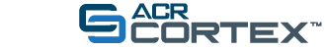
Marc H. Willis, D.O., M.M.M.
Clinical Professor of Radiology
Associate Chair of Quality Improvement
Department of Radiology, Stanford School of Medicine
Notes:
Introduction….
Welcome from the Radiology-TEACHES team.
First, I would like to share with you WHY Radiology-TEACHES was created.

Slide 2
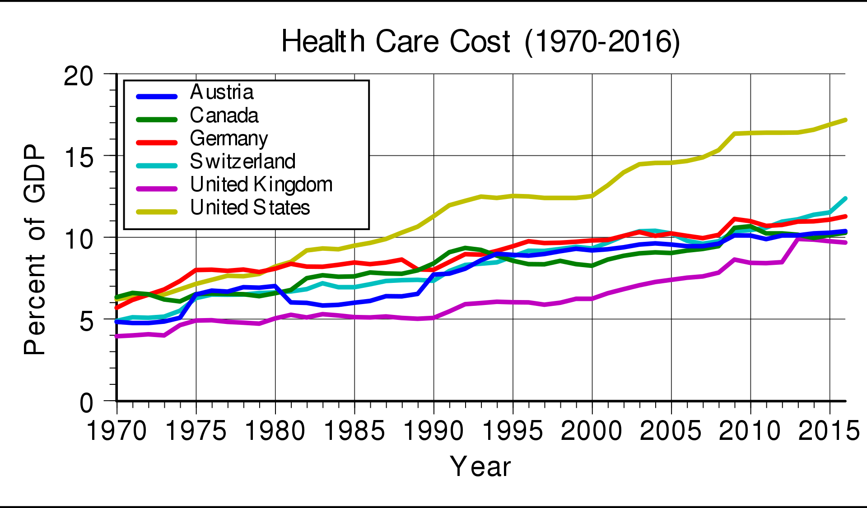
https://stats.oecd.org/Index.aspx?DataSetCode=SHA
Notes:
The cost of healtcare
2018 - $3.6 trillion and accounted for 18% of the GDP.

Slide 3
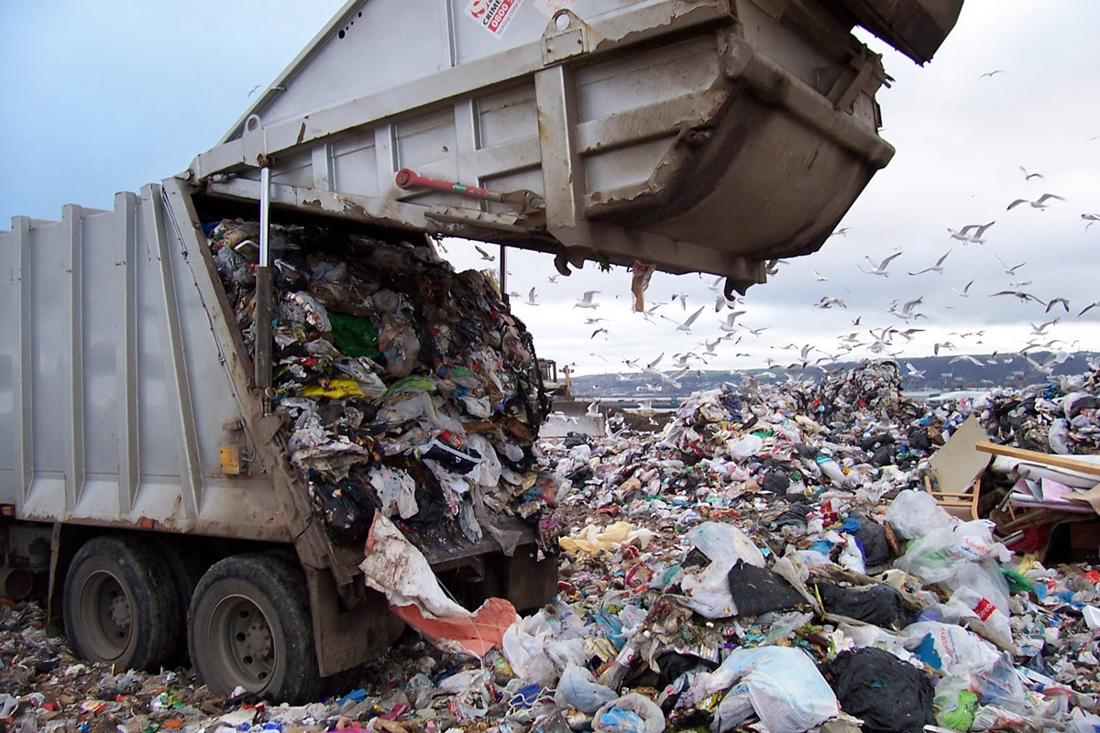
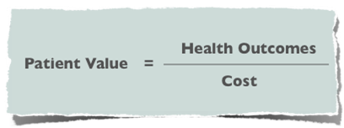
Notes:
Healthcare 20-40% WASTE
JAMA 2019
“It was stated that estimates of 30% or more of imaging examinations may be unnecessary, costing approximately $30 billion annually in the United States.”
Trends in Use of Medical Imaging in US Health Care Systems and in Ontario, Canada, 2000-2016 Rebecca Smith-Bindman, MD; Marilyn L. Kwan, PhD; Emily C. Marlow, MS; Mary Kay Theis, MSc; Wesley Bolch, PhD; Stephanie Y. Cheng, MSc; Erin J. A. Bowles, MPH; James R. Duncan, MD, PhD; Robert T. Greenlee, PhD; Lawrence H. Kushi, ScD; Jason D. Pole, PhD; Alanna K. Rahm, PhD; Natasha K. Stout, PhD; Sheila Weinmann, PhD; Diana L. Miglioretti, PhD
Rebecca Smith-Bindman, MD, department of radiology and biomedical imaging at the University of California San Francisco, and colleagues.
Some publications have suggested that anywhere from 20%–50% of high-tech imaging procedures fail to provide information that improves patient welfare and therefore may represent, at least in part, unnecessary imaging services (8–11).
20-40% waste
Burnout, patient over diagnosis and over treatment
Morale residue
Surveys:
Forbes 6% of doctors are happy with their jobs
Suicide rate 2x general population
>50% unsure if they would recommend medicine to young people
49% of radiologist burned-out
46% of physician report being burned-out

Slide 4
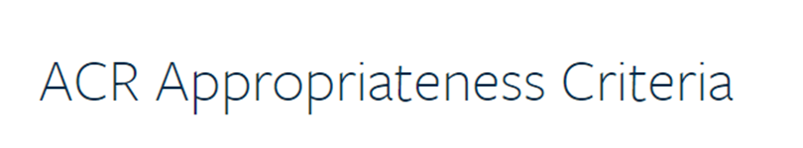
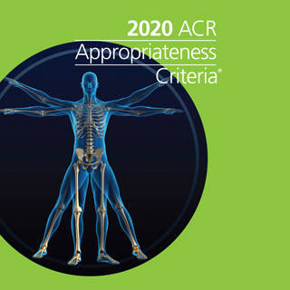
Participating Society
1. American Academy of Neurology
2. American Academy of Orthopaedic Surgeons
3. American Academy of Otolaryngology-Head and Neck Surgery
4. American Academy of Pediatrics
5. American Association for the Study of Liver Diseases
6. American Association for the Surgery of Trauma
7. American Association for Thoracic Surgery
8. American Association of Neurological Surgeons/Congress of Neurological Surgeons
9. American College of Chest Physicians
10. American College of Emergency Physicians
11. American College of Obstetricians and Gynecologists
12. American College of Phlebology
13. American College of Physicians
14. American College of Rheumatology
15. American College of Surgeons
16. American Gastroenterological Association
17. American Pediatric Surgical Association
18. American Psychiatric Association
19. American Society of Clinical Oncology
20. American Society of Echocardiography
21. American Society of Hematology
22. American Society of Nephrology
23. American Society of Nuclear Cardiology
24. American Society of Plastic Surgeons
25. American Thoracic Society
26. American Thyroid Association
27. American Urological Association
28. Canadian Association of Radiologists
29. Infectious Diseases Society of America
30. North American Society for Pediatric Gastroenterology, Hepatology & Nutrition
31. North American Spine Society
32. Society for Academic Emergency Medicine
33. Society for Cardiovascular Magnetic Resonance
34. Society for Pediatric Dermatology
35. Society for Pediatric Urology
36. Society for Vascular Surgery
37. Society of Cardiovascular Computed Tomography
38. Society of Critical Care Medicine
39. Society of General Internal Medicine
40. Society of Gynecologic Oncology
41. Society of Surgical Oncology
42. The Society of Thoracic Surgeons
43. World Professional Association for Transgender Health
Notes:
The American College of Radiology has recognized this developing problem any year ago.
Specifically, 27 years ago the ACR launched a Task Force formed late 1993 to address this issue and currently collaborates with over 40 Societies and 170 physicians in the effort to address appropriate utilization of medical imaging.
43 societies
Over 170 physicians

Slide 5
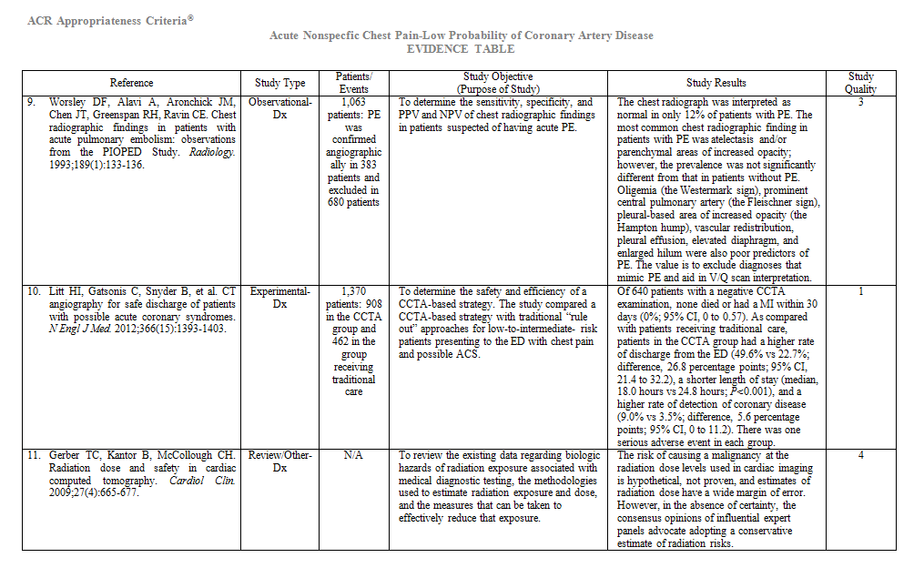
Sample Evidence Table
Notes:
Expert panels define appropriateness based upon the RAND/UCLA Appropriateness Method Users Manual (2001).
These reviews are performed annually and the current strength of evidence is summarized for a recommendation.

Slide 6
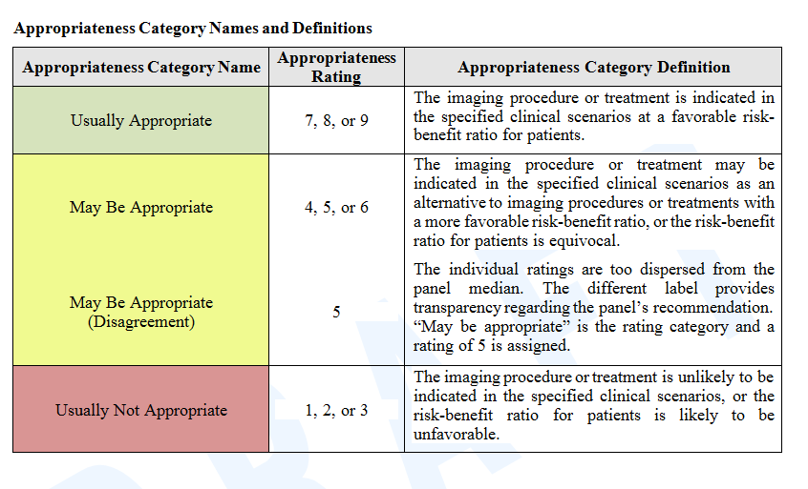
Appropriateness Category Names and Definitions
Notes:
The appropriateness recommendation is rated and then categorized into three levels of appropriateness.

Slide 7
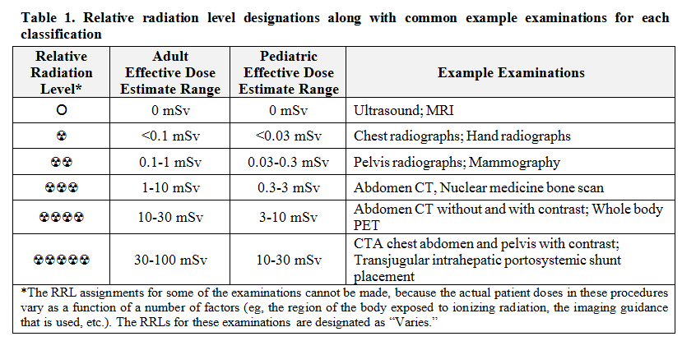
Relative Radiation Level
Notes:
Separately the relative radiation dose of each examination is considered. It does not impact the appropriateness category, but should be considered when considering the risk/benefit analysis of an examination.

Slide 8
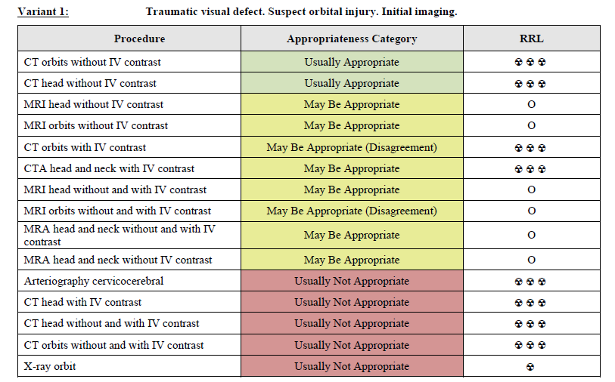
Appropriateness Criteria (AC) www.acr.org/ac
Notes:
The product of all of this work in an AC table, a template is displayed here.
These AC tables are freely available on-line and are published twice per year in the Journal of the American College of Radiology.
I should point-out that patient-friendly summaries of these topics began being published in the JACR in 2018.
This evidence-based information is fantastic, the problem can be consumability. In the middle of a busy clinic, it can be impossible for a medical provider to stop what they are doing and look up the AC panel relevant to the patient they are seeing.

Slide 9
American College of radiology
National Decision Support Company
Notes:
Recognizing this challenge, the ACR began partnering with National Decision Support Company in 2013 to provide a digitally consumable version of the Appropriateness Criteria. This product is called ACRSelect.
ACRSelect can be integrated with leading electronic health records (EHRs) to provide point-of-order entry clinical decision support.

Slide 10
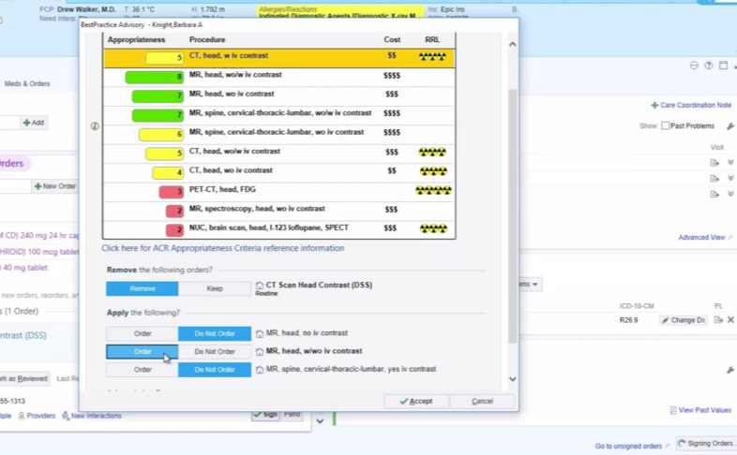


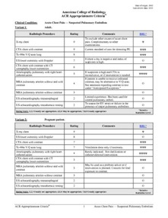
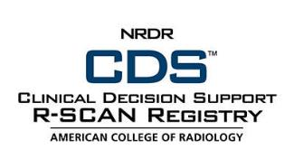

ACR Appropriateness Criteria®
Notes:
The product of all of this work in an AC table, a template is displayed here.
These AC tables are freely available on-line and are published twice per year in the Journal of the American College of Radiology.
I should point-out that patient-friendly summaries of these topics began being published in the JACR in 2018.
This evidence-based information is fantastic, the problem can be consumability. In the middle of a busy clinic, it can be impossible for a medical provider to stop what they are doing and look up the AC panel relevant to the patient they are seeing.

Slide 11
Protecting Access to Medicare Act
(PAMA)
2020 is an educational and operations testing period
Starting January 1, 2021, referring providers are required to consult appropriate use criteria (AUC) prior to ordering advanced diagnostic imaging services for Medicare patients
Advanced diagnostic imaging:
  CT
  MR
  Nuclear medicine and PET/CT
Notes:
In 2014 the PAMA law was passed.
2020 is an educational and operations year.
2021 CDS consultation and reporting is required or Medicare reimbursement will be impacted.

Slide 12

Notes:
In 2013, I saw what was going on in the clinical environment with CDS and it gave me an idea.

Slide 13

Notes:
Efforts to provide CDS at the point of order entry was great, but to have a meaningful impact at the magnitude needed, I believed was needed to address the issue on multiple fronts. To me, it didn’t make sense to keep educating physicians and advanced practice providers in many cases the same way we have been teaching for over a hundred years. In large auditoriums and the apprenticeship style of “see one, do one, teach one”.

Slide 14

Evidence-based medicine
Clinical decision support
Simulation
Learn it “right” the first time
Self-paced
Self-directed
Immediate feedback
+
Notes:
I asked myself how we can we do the following….
Provide EBM
Familiarize students to CDS
Do so in a low-stakes simulation learning environment
Help students learning it right the first time
Allow for self-paces and self-directed learning
And provide feedback immediately to students.

Slide 15
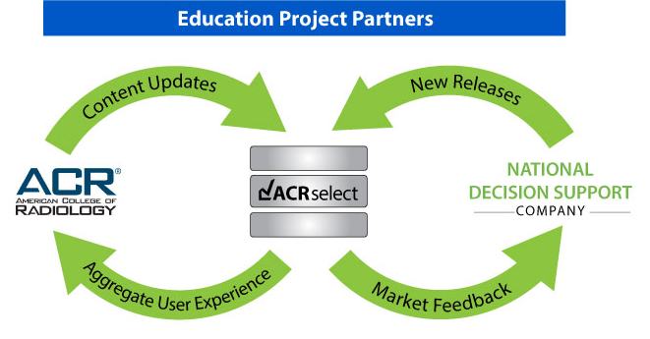
Notes:
This led to Radiology-TEACHES, an original collaboration between the ACR, NDSC, and my former institution Baylor College of Medicine.

Slide 16

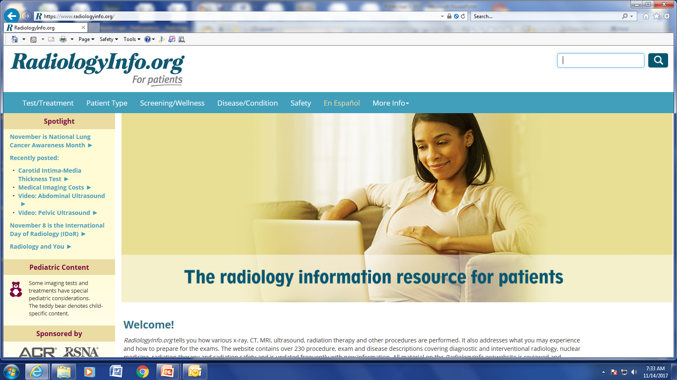
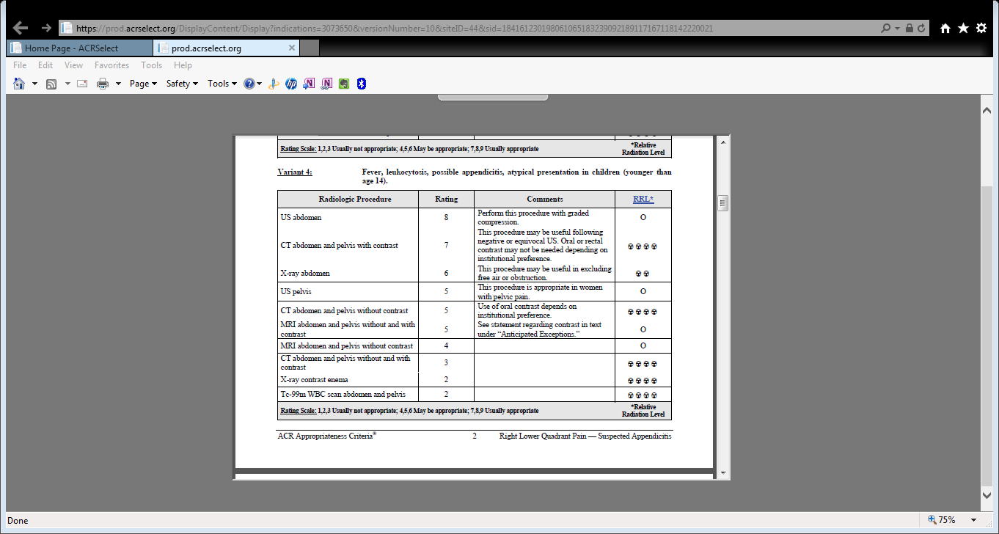
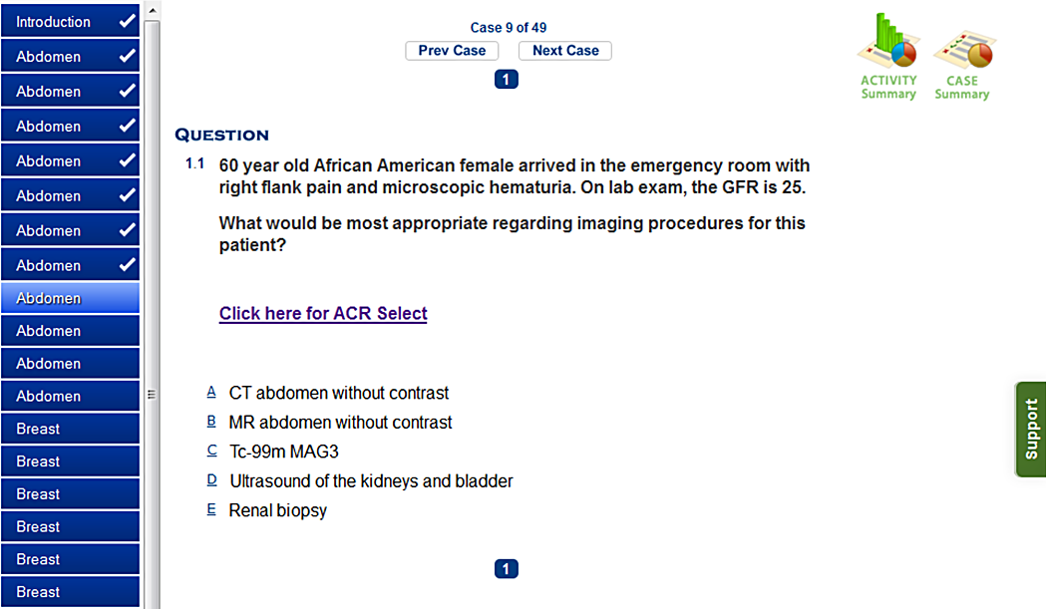
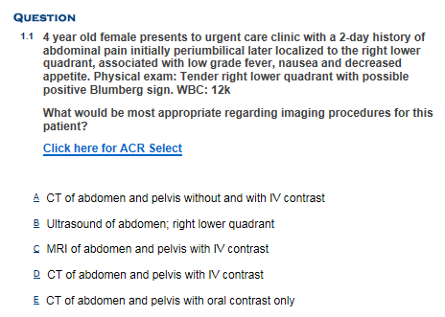
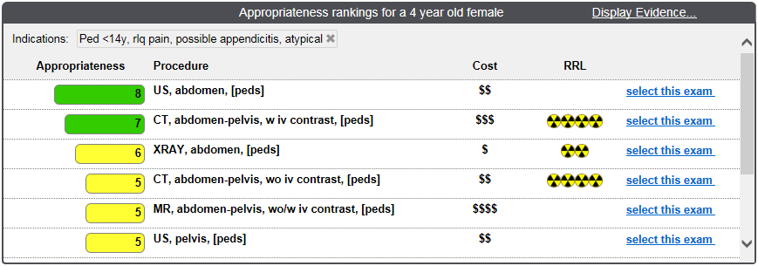
Decision Support
Notes:
Let me share with you a demonstration of the portal.

Slide 17
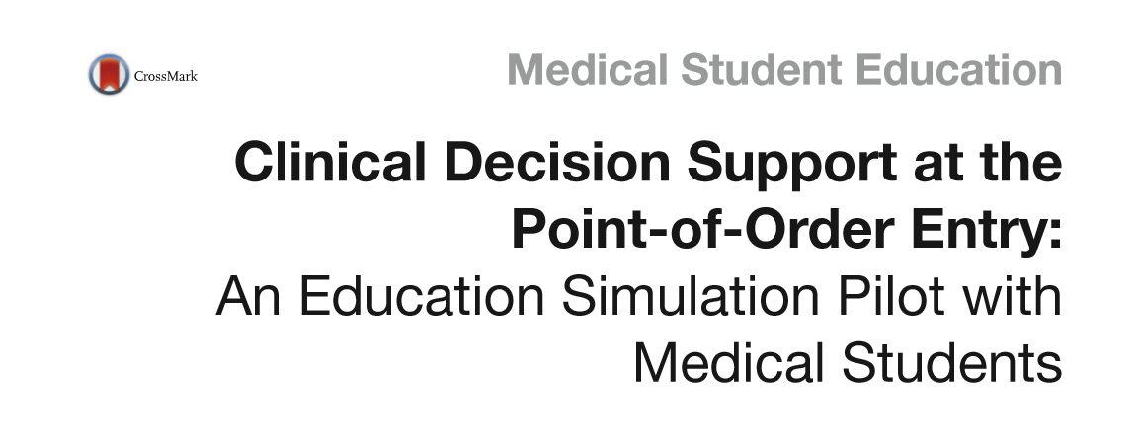
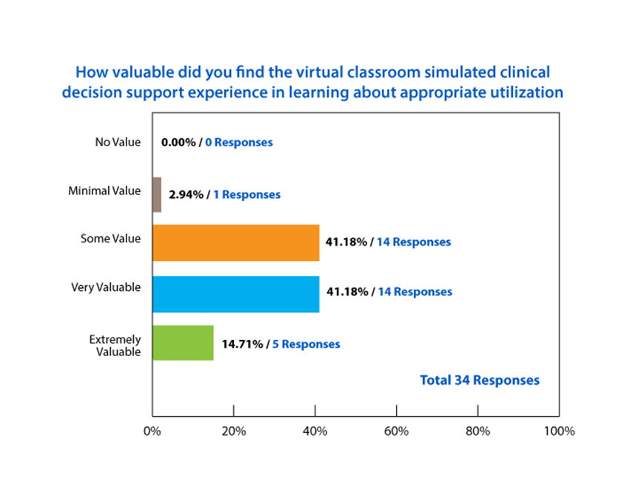
Willis, Marc H., et al. "Clinical decision support at the point-of-order entry: an education simulation pilot with medical students." Academic radiology 23.10 (2016): 1309-1318.
Notes:
We published the results of our pilot at Baylor in 2016.
You can refer to the article in Academic Radiology if you would like more details, but I will highlight that all of our participating students found Radiology-TEACHES valuable for their education.

Slide 18
RSNA Education Scholar Grant: Curriculum Integration
7
Core Clerkship Modules:
175
Family Medicine
OB/GYN
Internal Medicine
Psychology
Surgery
Pediatrics
Neurology
Medical students
Notes:
We subsequently received a grant from the Radiology Society of North America to evaluate integration of the modules into our 7 core required clinical clerkships. These modules we developed are freely available through Radiology TEACHES.

Slide 19
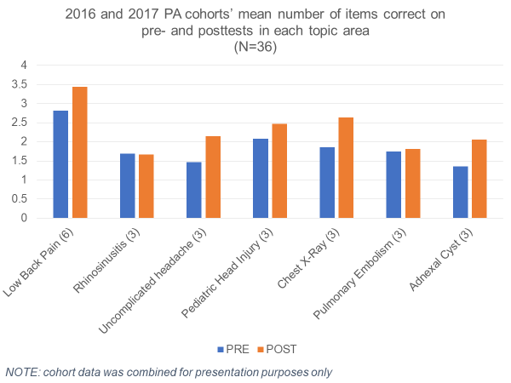
PA Program
Notes:
Our efforts extend beyond medical student education. In this study we partnered with our PA program and again saw positive results.

Slide 20
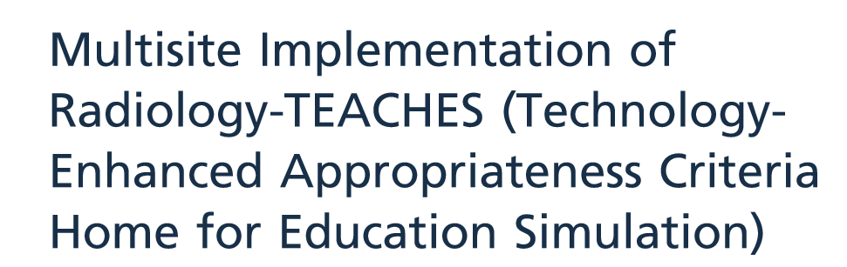
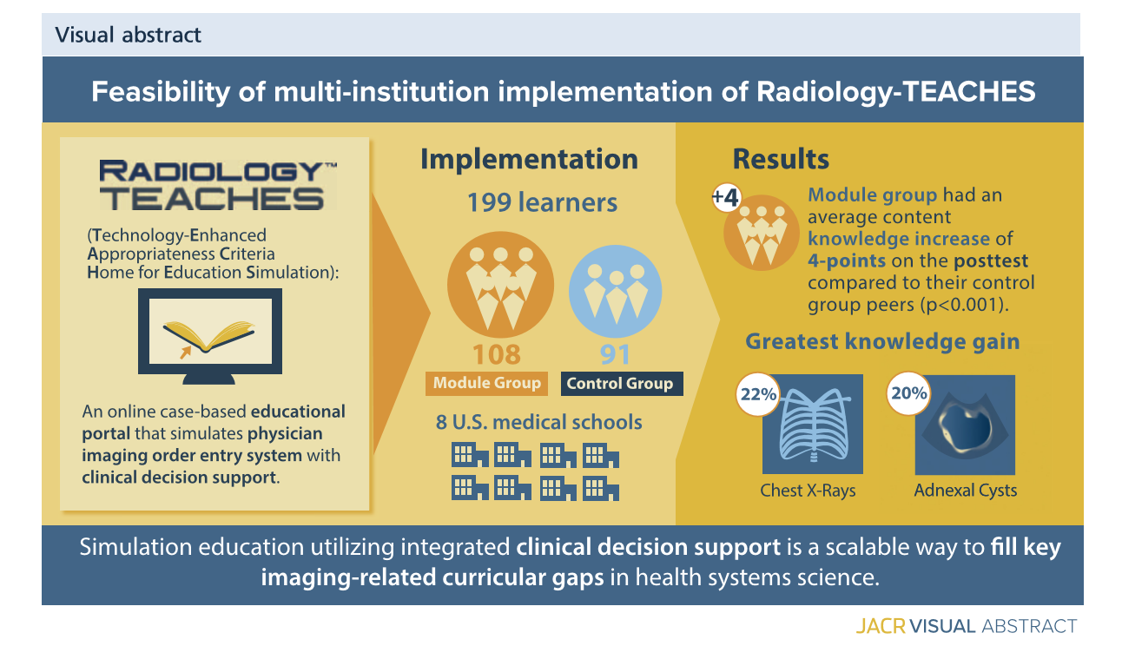
Willis, Marc H., et al. "Multisite Implementation of Radiology-TEACHES (Technology-Enhanced Appropriateness Criteria Home for Education Simulation)." Journal of the American College of Radiology (2020)..
Notes:
We wanted to ensure that what we were experiencing at Baylor was transferable to other schools; therefore we partnered with 8 other medical schools around the country to implement Radiology-TEACHES. We assessed 199 learners experience with the portal and found similarly encouraging results. This figure highlights students improvement in being able to appropriately request chest xrays for pre-op and pre-admission as well as for adnexal cysts.

Slide 21






2017 Costs of Care Creating Value Challenge
Teaching Value Innovator
Sponsors
Partners
Notes:
I have shared with you a summary of some of our studies, but you don’t have to just take my word for it.
In 2017, Costs of Care and the ABIM Foundation, two organizations helping lead the volume to value transition in health care named Radiology TEACHES their Teaching Value Innovator.

Slide 22

Thank you!
CDS for Imaging
Clinical Education
Appropriate imaging, CDS and Evidence-Based Medicine
PAMA mandate
44+ Schools
Appropriateness training in UME rotations (MD & DO)
Training for advanced practice providers (NP & PA)
Self-paced and measurable learning outcomes
Notes:
I sincerely hope you find Radiology-TEACHES valuable for your education.
Currently, we are partnering with >40 schools from around the country.
Thank you for your time and attention.
Together, I believe we can all help reduce waste and improve value in health care.

