Slide 1
When the Radiologist
Becomes the Patient
An Imaging 3.0 Case Study
July 16, 2018
These slides are disseminated to our respective members as a partnership of:

Slide 2
If you experience troubles playing the video, please copy and paste the following URL into your browser: https://youtu.be/LzzNLxR5nVo
Notes:
This slide is an opportunity to discuss how practices shift from Imaging 2.0 to Imaging 3.0.
WHO: Dr. Sabiha Raoof, Radiologist
WHERE: Chair of Radiology Departments at Jamaica Hospital Medical Center and Flushing Hospital Medical Center in Queens, NY
WHY: A personal struggle with breast cancer increased her awareness of the patient perspective and her desire to improve the patient-centered care provided by herself, her department and the entire hospital.

Slide 3
What & Impact
An American College of Radiology Imaging 3.0 Case Study
Alignment
Dr. Raoof approached the hospital CEO to see if she could begin rounding with patients
Socialization with Key Stakeholders
Senior staff members from emergency care, family medicine, and public affairs asked to join in
Inclusion and Diversity of Hospital Staff
Rounding expanded to other non-clinical staff members (e.g., finance, managed care, housekeeping)
Effective MAD Rounds
Reaches over 1/3 of all inpatients
Sustainable MAD Rounds
Launched and managed on an extremely limited budget
An Intrinsically and Extrinsically Rewarding Journey
Dr. Raoof’s career and job satisfaction have greatly benefited from this entire process
Dr. Raoof and James E. Villavicencio, administrator, Department of Family Medicine and Ambulatory Care Network at Jamaica Hospital, visit a patient during MAD rounds.
Notes:
ALIGNMENT Dr. Raoof approached the hospital CEO to see if she could begin rounding with patients to understand how the hospital could better help them.
SOCIALIZATION WITH KEY STAKEHOLDERS When the CEO mentioned Dr. Raoof’s visits during a meeting, senior staff members from emergency care, family medicine, and public affairs joined Raoof in the weekly visits, which was the genesis of the “Make a Difference” or MAD rounds.
INCLUSION AND DIVERSITY The rounds began with managers and directors of services and then expanded to include other non-clinical staff members (e.g., finance, managed care, housekeeping) who were not always aware of what happened in the life of a patient.
EFFECTIVE MAD rounds now reaches over 1/3 of all hospital inpatient and has been widely embraced by all parts of the organization and very well received by patients.
SUSTAINABLE MAD rounds have been developed and sustained on an extremely limited budget, which is very helpful to a hospital with a very small for investment in these types of projects.
INTRINSICALLY AND EXTRINSICALLY REWARDING For her work on MAD Rounds and other Imaging 3.0 initiatives in her institution, Dr. Raoof has since been named Chief Medical Officer of the hospital, become a ACR Fellow and appointed by CMS as a Faculty member for their Transforming Clinical Practice Initiative (TCPI).

Slide 4
Discussion Topics for Your Team
Do you maintain strong relationships with hospital administration to access funding for your department?
Does your department stay visible, and let others in the department and in the hospital know about new initiatives and how they can participate?
What contact does each member of your department have with patients and what have you learned collectively from your patients in recent months/years?

Slide 5
Actionable Items for Your Team
Find creative ways to interact with hospital patients on a regular basis. (e.g., introducing yourself in the waiting room)
Encourage other staff members to let patients know (preferably in person) that they are available to answer any of the patients’ immediate concerns.
Conduct a refresher training with all imaging staff on best practices for direct interactions with patients.

Slide 6
Implement Your Own Program
Based on your post-case group discussion and brainstorming, identify one way your team can implement Imaging 3.0 principles in your practice.
After implementation, submit your program for consideration as an Imaging 3.0 Case Study: https://www.acr.org/Practice-Management-Quality-Informatics/Imaging-3

Slide 7
Learn More About The MAD Rounds Case Study
The Written Case Study: https://www.acr.org/Practice-Management-Quality-Informatics/Imaging-3/Case-Studies/Patient-Engagement/When-the-Radiologist-Becomes-the-Patient
Voice of Radiology blog post by Dr. Raoof: https://voiceofradiologyblog.org/2015/03/05/yes-we-can-make-a-difference/
The 5 Minutes Video of This Case Study: https://www.youtube.com/watch?v=LzzNLxR5nVo
The ACR Patient- and Family-Centered Care Commission

Slide 8
Appendix of Additional Resources

Slide 9
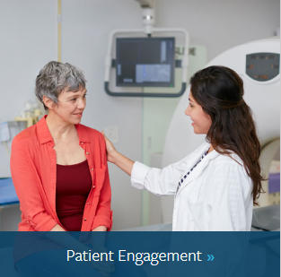
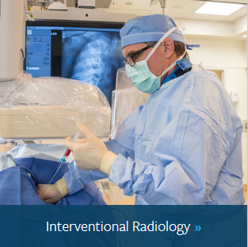
Read 100+ other ACR Imaging 3.0 Case Studies
ACR has 100+ Imaging 3.0 Case Studies that fall under the six categories below. Click each category to learn more:

Slide 10
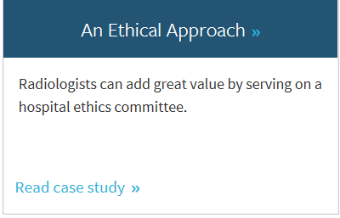
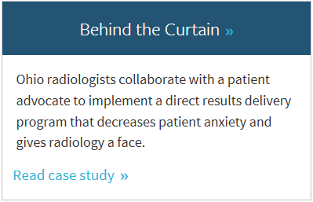
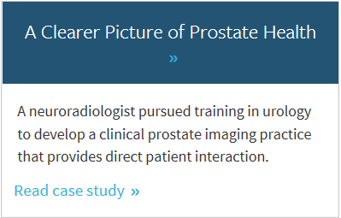
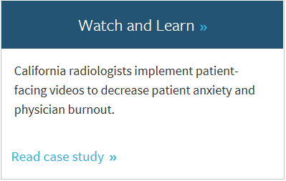
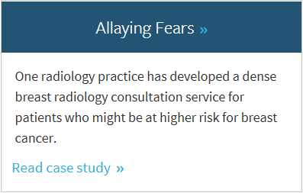
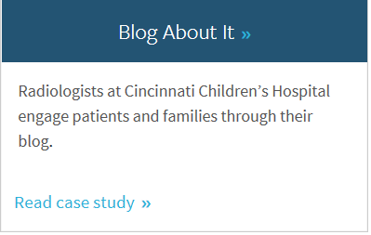
Imaging 3.0 Case Studies about Patient Engagement
For example, the Patient Engagement category features 20+ Imaging 3.0 Case Studies for further learning, including the 6 featured below:

Slide 11
Making the Connection Between Imaging 3.0 Case Studies and the Imaging Value Chain
An American College of Radiology Initiative

Slide 12
Imaging 3.0 Cases Demonstrate the Value Chain in Your Organization
Case Studies
Imaging Value Chain
The ACR’s Imaging 3.0 initiative is designed to help radiologists shape their future using tools and processes to improve practice management and patient care.
Connection Point
The JACR’s Imaging Value Chain is a series of peer-reviewed articles based on the five Imaging 3.0 pillars to help transition the practice of radiology from volume-based to value-based imaging care.
Practical, straight forward success stories you can use to implement improvements in your patient care and practice management today.

Slide 13
Learn More about Imaging 3.0 and The Imaging Value Chain
A series of 7 articles from the Journal of the American College of Radiology (JACR) describe the Imaging Value Chain.
TAKE ACTION: You and/or your team can make a connection between the topics raised in this Imaging 3.0 Case Study and the Imaging Value Chain by focusing on articles #2 and #6.
Overview of the Imaging Value Chain
#1 - Delivery of Appropriateness, Quality, Safety, Efficiency and Patient
#2 - Appropriateness, Scheduling, and Patient Preparation
#3 - Protocol Design and Optimization
#4 - Optimizing Modality Operations
#5 - Actionable Reporting
#6 - Communication of Actionable Information
#7 - Business Intelligence, Data Mining, and Future Trends

Slide 14
Thank You
If you have questions, please contact Chris Hobson:
chobson@acr.org
These slides are disseminated to our respective members as a partnership of:

Slide 15
License
This case study by American College of Radiology is licensed under a Creative Commons Attribution NonCommercial-NoDerivatives 4.0 International License
Based on a work at www.acr.org
Permissions beyond the scope of this license may be available at www.acr.org/Legal

