Slide 1
“AUC Mandate – Countdown to Launch!”
October 9, 2019

Slide 2
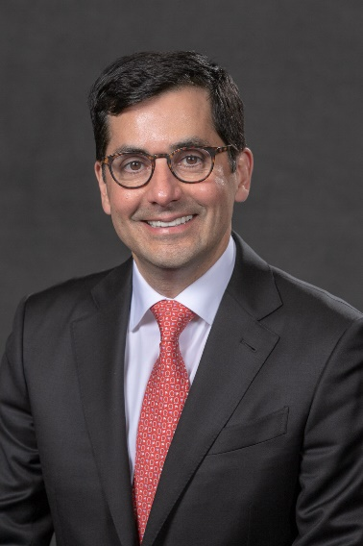
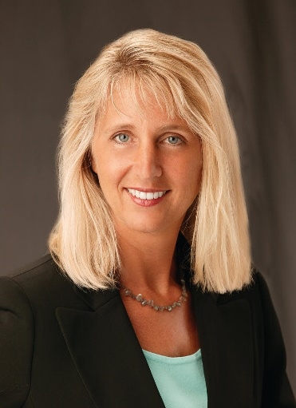
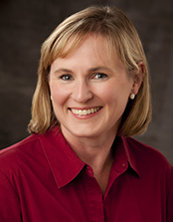
Presenters
Ezequiel Silva, MD
Linda Wilgus, CPA,
Jen Coleman
Molly Craven, MD
Notes:
ACR Economics Commission Chair Dr. Ezequiel Silva will briefly explain current Clinical Decision Support requirements.
Linda Wilgus - RBMA Federal Affairs Committee Chair - explores how the mandate impacts business managers and why your practice should work with referring providers now to get ready.
Mike Bohl, I-H-E International Radiology Planning Committee Co-chair, and Chief Operations Officer, Radiology Group, PC, SC - outlines steps you can take to implement CDS in your practice and interact with CDS on a daily basis.

Slide 3
Q+A Panelist
Bob Cooke Vice President National Decision Support Company
Care Select™ Imaging/ACR Select®
Notes:
SHAWN FARLEY –
After the presentations - We will be joined during the Q+A Session - by Bob Cooke – Vice President of the National Decision Support Company.
With that – we will get right into our first presentation by Dr. Ezequiel Silva.
Dr. Silva?

Slide 4
Helpful Reminders
Check Audio Setting (Computer vs Phone)
Type Questions Into “Questions” Pane
Will Receive Webinar Recording Link
Post-Webinar Survey in Follow-up Email

Slide 5
Imaging Appropriate Use Criteria The Latest Heading Into 2020
Ezequiel Silva, MD ACR Economics Commission Chair

Slide 6
Past Webinars in this Series
Sept 2018
Dec 2018
Feb 2019
Find links to these webinars at ACR.org/CDS

Slide 7
The Acronyms
PAMA: Protecting Access to Medicare Act
AUC: Appropriate Use Criteria
qCDSM: Qualified Clinical Decision Support Mechanism
PLE: Provider-led Entity
FP: Furnishing professional
OP: Ordering professional
PCA: Priority Clinical Areas

Slide 8
Original Timeline
NOV 15 2015
APR 1
2016
JAN 1
2017
JAN 1
2020
Specify
AUC
criteria
List
qCDSMs
Consultation
required
Outliers
identified
March 31, 2014: PAMA Becomes Law

Slide 9
Updated Timeline
Latest implementation schedule in 2019 Final Rule ***
JULY
2018
DECEMBER
2019
JANUARY
2020
JANUARY
2021
JANUARY
2023 OR 2024
Voluntary Reporting Period
-QQ Modifier
Educational
and Operations
Testing Period
Start Date
(Payment at
Risk)
Outliers
identified
Educational
and Operations
Testing Period
*** No updates in 2020 MPFS proposed rule

Slide 10
CMS Rules for AUC Program
Ordering professionals must consult AUC.
Consultation via qCDSM software integrated in EHRs or via stand-alone web-based portals
There must be at least one qCDSM that offers a no cost web-based portal (currently 3 free options)
Tool must provide immediate feedback to ordering professional on appropriateness guidance.
Agency approves multiple qCDSMs (currently 15 options) capable of either integrating directly into, or are seamlessly interoperable with, existing health IT systems.

Slide 11
New Information About the Program – Dec 2018
https://www.cms.gov/Outreach-and-Education/Medicare-Learning-Network-MLN/MLNProducts/Downloads/AUCDiagnosticImaging-909377.pdf

Slide 12
More Recent Information on the Program
Nothing about AUC in the CY2020 Medicare Physician Fee Schedule Proposed Rule
Claims Guidance (Released July 2019)
CMS Transmittal 2323 (CR11268)
https://www.cms.gov/Regulations-and-Guidance/Guidance/Transmittals/2019-Transmittals-Items/R2323OTN.html
MLN Matters: MM11268
https://www.cms.gov/Outreach-and-Education/Medicare-Learning-Network-MLN/MLNMattersArticles/downloads/MM11268.pdf

Slide 13
Priority Clinical Areas
8 Priority Clinical Areas
For Outlier determination
“Upon full program implementation, please note that AUC consultation is required for all advanced diagnostic imaging services, not just those within the priority clinical areas.”

Slide 14
Outliers
Will be subject to prior authorization
“Before the prior authorization component of this program begins, there will be notice and comment rulemaking to develop outlier methodology”
Source: CMS Transmittal 2323

Slide 15
What is expected heading into 2020?
Existing timeline re-stated
2020: Education and Operations Testing Period
“During this phase of the program claims will not be denied for failure to include…or for misreporting AUC information…”
“During CY 2020 we expect ordering professionals to begin consulting qualified CDSMs and providing information to the furnishing practitioners and providers for reporting on their claims.”
2021: Full implementation ***
“Full program implementation is expected January 1, 2021.”
Source: CMS Transmittal 2323

Slide 16
Claims processing in 2020
NPI of the ordering professional must be on claim.
There is a distinct G-code for each of the qualified CDSMs.
G1000 – G1010
Eight new modifiers were created for AUC outcome

Slide 17
Hardship Modifiers
Ordering professional is not required to consult a clinical support mechanism due to:
MA: Patient with suspected or confirmed emergent condition
MB: Insufficient Internet Access
MC: EHR or CDSM vendor issues
MD: Extreme and uncontrollable circumstances

Slide 18
Adherence Related Modifiers
The order:
ME: Adheres to the AUC in the CDSM consulted
MF: Does not adhere
MG: Does not have an AUC in the CDSM consulted

Slide 19
Unknown
MH: Unknown if OP consulted a CDSM…related information was not provided

Slide 20
Operational Questions
CMS Aware of several issues and working towards solutions
“A subsequent CR will follow at a later date that will further operationalize this AUC policy.” (CMS Transmittal 2323)

Slide 21
Operational Questions
Where will the ordering provider’s NPI go on the facility claim form?
How will “adhere” and “not adhere” be defined?
qualified PLEs, including the ACR, are currently working on this
How will claims be handled where there are multiple imaging tests ordered by different providers, using different CDSMs?
How will AUC information between OP and FP be shared, documented and maintained?

Slide 22
Critical Access Hospitals
CMS has stated that critical access hospitals (CAHs) are not “applicable settings”.
How will CMS know if a professional component claim was for an imaging test performed at a CAH?

Slide 23
Questions may be sent to PAMA-AUC@acr.org at any time.

Slide 24
Getting Ready for Appropriate Use Criteria How do radiology groups prepare?
Linda Wilgus, CPA, MBA
RBMA Federal Affairs Committee Chair

Slide 25
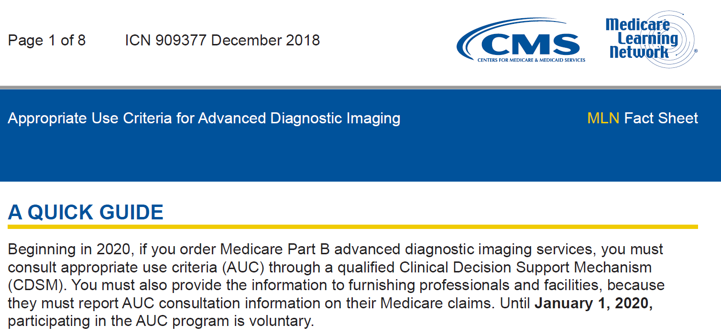

Slide 26
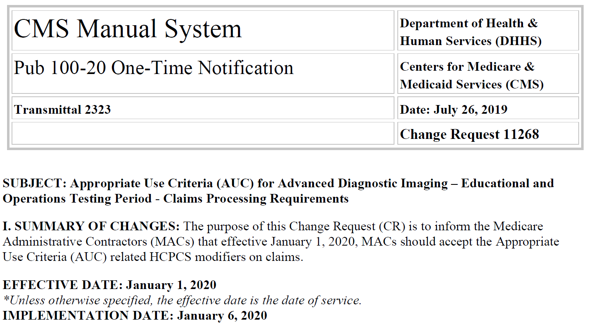

Slide 27
What we know…..
As of today the program has not been delayed, therefore 1/1/2020 will begin the operational and testing year for Appropriate Use Criteria.
No financial penalties will be assessed during this time period.
Beginning January 1, 2021 Medicare reimbursement to rendering providers will be contingent upon this reporting.
It does not matter it the exam adheres or does not adhere to appropriate use criteria for payment to be rendered, only that AUC was consulted.
This program applies only to traditional Medicare patients, not Medicare Advantage patients.

Slide 28
What we know…..
CMS has made the following exceptions for AUC consultation/reporting:
Emergent services when provided to patients with emergency medical conditions as defined by EMTALA.
Inpatients
Critical Access Hospitals
Ordering professional that experience a significant hardship such as:
Insufficient internet access
Electronic Medical Records or CDSM issues
Extreme and uncontrollable circumstances

Slide 29
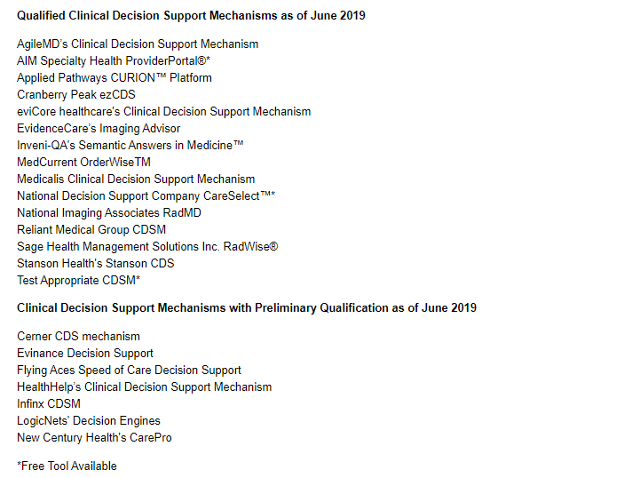
How to find a clinical decision support mechanism? Check with your EMR vendor or CMS website, illustrated here. * means a free version is available on the web.
What we know….. The CDSMs

Slide 30
What we know…..The G Codes

Slide 31
What we know….. The Modifiers

Slide 32
What we don’t know…
Is the industry ready?
How will the Emergent/EMTALA exemption be interpreted in the ER setting?
We are still uncertain about the Critical Access Hospital exemption and the billing of the professional component? Will the MACs automatically recognize this relationship? Will we need to add a modifier?
How best to communicate AUC consultation when the charge line has exceeded the limit of 4 modifiers?
When an exam has been changed, does AUC need to be consulted again?
When Medicare is the secondary payor?
Will CMS recognize the MH modifier in 2021 when the financial penalties are implemented?

Slide 34
What should we do….
Radiology providers should be discussing with their billing vendors/software platforms on their readiness to process the identified G Codes and Modifiers.
From an electronic order interface
From a manual process
Educate your physicians and staff about the program.
Implement processes and workflows
Audit and report compliance
Communicate compliance to ordering providers

Slide 35
What should we do… Hospital Partners
Is your hospital leadership aware of this requirement?
Meet with those in charge of the implementation.
Offer to be a part of the implementation team.
Meet regularly and often.
Find out how are they educating their referring providers regarding this AUC requirement.
Understand how the hospital will be passing the G Code and modifier information to your organization within your billing files.
If electronic interface, involve those responsible as early as possible for programming efficiency.
Discuss/resolve “feedback” to referrers who are not yet complying with the requirement.

Slide 36
What should we do…..Referring Providers
Run a report of your referring providers, create a plan on how to meet/educate them on AUC.
Have them check with their EMR vendor to see if they have integrated with or plan to integrate with a Clinical Decision Support Mechanism (CDSM).
Tell them to sign up for a qualified CDSM’s free version.
Help them document their strategy for AUC compliance.
They should understand their workflow, involve/educate their schedulers.
They need to educate their physicians and physician extenders on AUC requirements.
They should have regular, ongoing meetings with your radiology provider to communicate implementation. Ask to be a part of their implementation team.
Ask them how they plan on providing the AUC/CDS G Code and modifier to the rendering/radiology provider.
Continue to check CMS web site for additional guidance.

Slide 37
We are all in this together….
Share with ACR & RBMA colleagues what works/doesn’t work.

Slide 38
Dr. Molly Craven, Family Practice Jennifer K. Coleman, MHSA, FACHE
Experience in Northern Michigan: moving from “trials” to “testing”

Slide 39
Why CDS in Northern Michigan?
Began as our group was looking for ways to stay relevant and provide that “added value” to our colleagues
Local physicians had shared their frustration
Intrigued by AUC technology solution
CMS rumors
Early 2014, our group proposed a pilot/trial to the physician organization who supported the pilot and the goal of future discussions with payers for an improved process
This trial laid the groundwork for future adoption of CDS necessary for CMS

Slide 40
Overview of the CDS Trial in Northern Michigan
Conducted before PAMA legislation
Primary Goals:
-Address ordering frustrations
-Improve appropriateness of orders
-Provide real-time order feedback
-Investigate the feasibility of using an AUC tool
-Determine if physicians find the tool to have clinical utility

Slide 41
Could a tool work in the office?
“Palatability test”
Could it benefit physician offices?
Could it benefit patients?
Could it be adopted into to the workflow?
Would physicians use it?
Do physicians find that the tool has clinical utility in their practices?

Slide 42
Trial Overview
Nine practices who were members of the physician organization
Physicians had to use the tool (not staff)
Use tool along side prior auth processes (double work for participants)
Limited duration for the trial
Physician organization provided funding for the project (tool cost and small stipend to participants)
No integrated products existed at the time of the trial
Trial designed with statistician as a formal study

Slide 43
Northern Michigan Model
Request via EMR/EHR or via web portal
Order Exam with “auth”/DSN (No DSN No Exam)
ACRselect assigns score
(0 to 9)
“Auth” (DSN) data sent to claims warehouse
High scores
ACR Select overruled with local radiologist discussion & approval
Exam performed
To TPA
Low Scores
If low score exam is performed: Low Score shows up on ordering provider imaging report card to track trends/educate/take action
Low Score ACRselect score upheld
In order to proceed with a low score, the ordering provider must discuss case with regional radiologist panel prior to proceeding-documentation of radiologist approved exception for low score will be made

Slide 44
Key Results? The ordering providers found utility and sustainability in using the tool
Improvement in appropriateness of imaging orders
Flexibility to meet the needs of their individual patients with less administrative cost
Better approach for guiding medical imaging ordering
Quick and easy feedback
More confidence in ordering
Use of the tool in real-time provided hands-on learning
Useful educational tool
Preferred the tool over pre-authorization
Enhanced communication & collaboration
Supports consultative role of the radiologist
Greater capacity to discuss clinical options with radiologists
The trial provided an opportunity to share findings with payers

Slide 45
Results = key to future implementation
Positive results make it easier to have conversations with providers as we move toward implementation
Provided some practice before any go-live
“have the ear” of payers

Slide 46
Dr. Molly Craven: background
Self-described: “One of the last paper-trained residents; IT-challenged.”
Without help from advance care practitioners,
“I do ALL prior-authorizations”
Participated in CDS trial for three (3) years, while still utilizing RBMs (Radiology Benefit Managers).
Observed differences:
CDS assumes need for study; Algorithm determines correct study, explaining why.
RBM assumes knowledge of correct study; algorithm makes you prove it.

Slide 47
RBM vs CDS
RBM
CPT/Dx Code
Multiple Choice Questions
(Hours to days later…)
? Provide Additional Info?
Denial Peer-Peer Approval Consult
CDS
Symptoms Dx/Body Area
(Immediate Feedback)
Recommended Study-No Hard Stop
Evidence-based AUC with
Resources & References Provided

Slide 48
Benefits to the physicians
CDS cuts time in half
RBM process requires multiple steps.
With CDS, Peer to Peer Outcome reaches 100% coverage
Time Saved:
No need to look up CPT codes
No interrupting Radiologist for preliminary information
…Why couldn’t CDS just replace Prior Auth?

Slide 49
Benefits to the Patients
Speed of Approval
Graded recommendations customizes plan for complex patients
Provides educational resources for anxious or demanding patients requesting studies

Slide 50
Post trial
Voluntary use of tool
Continue payer discussions (two payer test programs)
Face to face training of offices participating test programs
Educational meetings with physician organization, physician hospital organizations, providers, specialty section meetings and the health systems
Formally identified and educated “Key Champions” for CDS – GTR and Health System
Facility completed system integration of a CDS tool with a phased roll-out to the providers who place their orders using the health system EHR (inpatient, outpatient, ED)

Slide 51
Continued…
RSCAN topics used by radiologists to engage ordering providers in discussions
Data review & scenario testing
Education regarding the legislation and go live date
Education provided at section meetings as well as meetings with individual offices
Radiologist/health system newsletter
Last phase is to engage private practices not using the health system EHR for ordering imaging studies (integrated and non-integrated)
Considering creation of practice cases for offices as they learn how to use the tool

Slide 52
Ordering provider resources:
Radiologists (real time, hotline)
Radiologists’ administrative team
Dr. Craven
Health system’s project team
Tool’s evidence documentation within the tool (“display evidence”)
Physician organization
Local guides and training materials
National toolkits

Slide 53
Status of our marketplace
Readiness score? +/- 70% of orders
Health System has rolled out the tool integration – not all system facilities are fully functional to date
Radiologists fielding questions and reviewing order data – utilizing QA process to question orders submitted through the tool
Independent practices slow to adopt
Education and training are ongoing, prioritizing high volume independent ordering physicians first
1/1/2020 go live discussions

Slide 54
ACR Resources for CDS Implementation
Collection of CDS preparedness materials at: ACR.org/CDS
R-SCAN at: www.rscan.org. New: Practices with CareSelect Imaging can now participate in the CDS R-SCAN Registry.
R-SCAN and CDS Imaging 3.0 Case Studies at: https://rscan.org/images/PDFs/RSCAN-Imaging-3.0-Resources-flyer_WEB_F2.pdf
Materials for referring physicians at: https://www.acr.org/Practice-Management-Quality-Informatics/Practice-Toolkit
PAMA Brochure
CME-earning Simulations and Podcasts
AC Patient-Friendly Summaries
Notes:
Shawn Farley will read this.

Slide 55
Webinar Poll Questions
Which option best describes your profession?
Which professional organization do you belong to?

Slide 56
Thank You Questions?

Slide 57
“AUC Mandate – Countdown to Launch!”
October 9, 2019
Good Night!

