Slide 1
Medicaid Update: Current Status and How You Can Get Involved
Richard Benator, M.D., F.A.C.R.
ACR Pediatric Chair Economics
SPR Chair Public Policy
Vice Chair Division of Radiology
All Children’s Hospital
St. Petersburg, FL

Slide 2
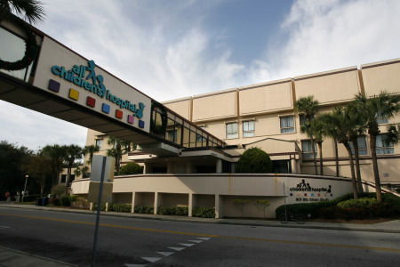
My Story
October 1988
All Children’s Hospital 115 beds
Private pediatric radiology practice
Affiliated with USF Radiology Residency Program
30% Medicaid
Notes:
Dollar for dollar first 70 patients, next 30 patients 50% on the dollar. Then I was making about 85% of the salary line of the adult radiologist next door at Bayfront hospital
2

Slide 3
Increasing Medicaid population 35 to 40% -> funding crisis
Legislative process
Initiated by hospitals in the State of Florida
Disproportionate increased funding to Hospitals that do more than 35% Indigent care
Did not include the doctors within those hospitals

Slide 4
7 to 8 years ago – radiology services were crashing and burning
Volumes increasing, not being able to keep up
Difficulty recruiting Pediatric Radiologists
Shortage of pediatric radiologist
Worsening Medicaid percentage
Stipend from hospital to support radiology services

Slide 5
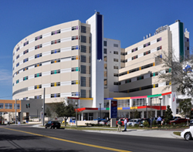
Then about 3 to 4 years ago our hospital wanted to change the model and employ us
October 2011 Medicaid now at 70%
Notes:
Dollar for dollar first 30 patients, next 70 patients 50% on the dollar. Then now we are drawing about 65% of the salary line of the adult radiologist next door at Bayfront hospital. For now I am shielded from the reality of those economics.
5

Slide 6
Medicaid financial pressure persists and worsening
Disproportionate funding does not include the Doctors from the original legislation.
Medicaid funding cut backs are occurring
Hospital is mounting a psychological effort and positioning itself to reduce payment to Radiological and other physician services.

Slide 7
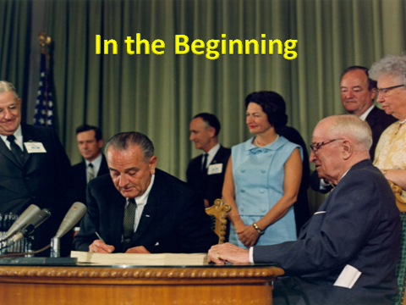
Center for Medicare and Medicaid Services
Medicaid
Title XIX of the Social Security Act
Joint Federal –State Program 1965
Notes:
Design: to provide health insurance for individuals with low income
At risk due to federal and state budget deficits
Many states are already well below Medicare rates
7

Slide 8
Medicaid Designed
Provide health insurance for individuals with low income
Federal Government pay about 57% of Medicaid expenses per year
Many states are already well below Medicare rates
Medicaid in the cross hairs: Recent Budget Changes could threaten State Funding & Medicaid Reimbursement: ACR Bulletin, July/August 2011; Brian Kuszyk, MD & Eugenia Brandt
Notes:
8

Slide 9
Funding for Medicaid is not getting better
The majority of state budgets are devoted to healthcare
22 billion a full 1/3 of the state budget in Florida goes to Medicaid funding.
North Carolina more than 18% of state's population is Medicaid eligible
Education programs
Notes:
FL has setup five Medicaid districts and has privatized Medicaid to third party insurance companies. The legislators want these third party insurance companies to manage the outflow of money for Medicaid services. The state is looking for a waiver from CMS
It represents 17% of the NC budget
Medicaid is one of the primary means to provide health care to the uninsured citizens
9

Slide 10
Two critical implications
Cuts to radiologists and other physicians have already begun
Costs of billing for some relatively value unit studies, exceed their reimbursement
Although funding from the American Recovery and Reimbursement Act (ARRA) was given, 39 states implemented a provider cut or freeze, because provider payments are linked to economic conditions in those states
States are starting to use and require other third party entities to curtail the growth in Medicaid services
Radiology Benefit Managers (RBM)
Requiring and/or developing Online decision support systems
Notes:
Two critical implications
Cuts to radiologists and other physicians have already begun
Costs of billing for some relatively value unit studies, exceed their reimbursement
E.g., Plain films
Despite this we are require to bill Medicaid for services provided to Medicaid patients
Although funding from the American Recovery and Reimbursement Act (ARRA) was given, 39 states implemented a provider cut or freeze, because provider payments are linked to economic conditions in those states
This was done for immediate impact on the state’s budget, as they felt they had to have fiscal restraint,
States are starting to use and require other third party entities to curtail the growth in Medicaid services
Radiology Benefit Managers (RBM)
Requiring and/or developing Online decision support systems
Minnisota, Washington & North Carolina
10

Slide 11
Patient Protection and Affordable Health Care Act
With the economy as it is now, it is predicted that as this act is implemented,
more US citizens will find themselves on the Medicaid roles.
More pressure on funding Medicaid

Slide 12
Bibb Allen “RUC Ruckus” ACR Bulletin, June 2011
Relative Value Update Committee
26 member multispecialty expert panel of physicians
Convened by the AMA and sponsored by the physician specialty groups
Providing input into the Medicare fee-for-service system for two decades
Establishing relative values for new and revised Current Procedural Technology (CPT) codes
Has worked with CMS for each of the statutory five year reviews of the Medicare Physician Fee Schedule
CMS attends each RUC meeting
Notes:
Relative Value Update Committee
26 member multispecialty expert panel of physicians
Convened by the AMA and sponsored by the physician specialty groups
Providing input into the Medicare fee-for-service system for two decades
No cost to tax payers
Establishing relative values for new and revised Current Procedural Technology (CPT) codes
Has worked with CMS for each of the statutory five year reviews of the Medicare Physician Fee Schedule
> 7000 CPT codes
CMS attends each RUC meeting
At CMS’s option
Accepts, rejects or modifies any recommendation
12

Slide 13
RUC is under heavy fire
American Academy of Family Physician (AAFP)
Even though in 2007, though the RUC review process, which resulted in a 37% increase in payment for office visits. This was a significant redistribution of health care dollars from specialists to primary care.
AAFP is looking to have an outside analytic entity make RVU recommendations, so as to effect an even greater share of the health-care dollars.
Notes:
RUC is under heavy fire
American Academy of Family Physician (AAFP)
Even though in 2007, though the RUC review process, which resulted in a 37% increase in payment for office visits. This was a significant redistribution of health care dollars from specialists to primary care.
The US congress legislatively mandates CMS, if the proposed RUC dollar redistribution is significant, that the adjustment be budget neutral, i.e., a zero sum adjustment between the doctors
AAFP is looking to have an outside analytic entity make RVU recommendations, so as to effect an even greater share of the health-care dollars.
Medicare Payment Advisory Commission (MedPAC)
CMS
Congressional member Jim McDermott (D-WA) and MedPAC Chairman Glen Hackbarth have been critical of the RUC
Jim McDermott (D-WA) has introduced legislation to require an outside contractor to supplant the RUC process
Does not require that all codes be evaluated and may well lead to cherry picking codes
Its methodology is not stipulated
Implies that the RUC determines how much various specialties earn
Rather CMS and Congress actually controls and determines how much money goes into physician services
Congress has mandated reductions in physician payment
1.8 billion per year that came from the deficit Reduction Act of 2005
13

Slide 14
RUC is under heavy fire
Center for Medicare and Medicaid Services (CMS)
Congressional member Jim McDermott (D-WA)
introduced legislation to require an outside contractor to supplant the RUC process
Medicare Payment Advisory Commission (MedPAC)
MedPAC Chairman Glen Hackbarth
Notes:
Medicare Payment Advisory Commission (MedPAC)
CMS
Congressional member Jim McDermott (D-WA) and MedPAC Chairman Glen Hackbarth have been critical of the RUC
Jim McDermott (D-WA) has introduced legislation to require an outside contractor to supplant the RUC process
Does not require that all codes be evaluated and may well lead to cherry picking codes
Its methodology is not stipulated
Implies that the RUC determines how much various specialties earn
Rather CMS and Congress actually controls and determines how much money goes into physician services
Congress has mandated reductions in physician payment
1.8 billion per year that came from the deficit Reduction Act of 2005
14

Slide 15
What are we worried about?
Methodology of payment decisions are not stipulated
Cherry picking codes to reduce
More complexity and reduction of input from Medical specialties
Implies that the RUC decides which and how much specialties get paid
CMS and Congress decide how much money goes to physician services
Notes:
Unfortunately, there is a large political line separating medical specialist from primary-care physicians
15

Slide 16
Significant political line separating medical specialist from primary-care physicians
In opposing the McDermott bill and supporting the RUC
“United we stand and divided we fall”
We should do what we can to support the RUC & hope that other medical specialties agree
Notes:
In opposing the McDermott bill and supporting the RUC
E.g., Orthopedics & Neurosurgery co-signed a letter in opposition,
Several primary-care physician groups did not sign that letter
The stage is set for a battle over the future of health-care and physician payments
There is an old saying “United we stand and divided we fall”
In turning the recommendations over to third party,
More complexity and reduction of input from Medical specialties
We should do what we can to support the RUC & hope that other medical specialties agree
RUC process five year review
Ongoing issue is gaining strength
RVUs for cognitive evaluation vs procedural physician charges are to odds
16

Slide 17
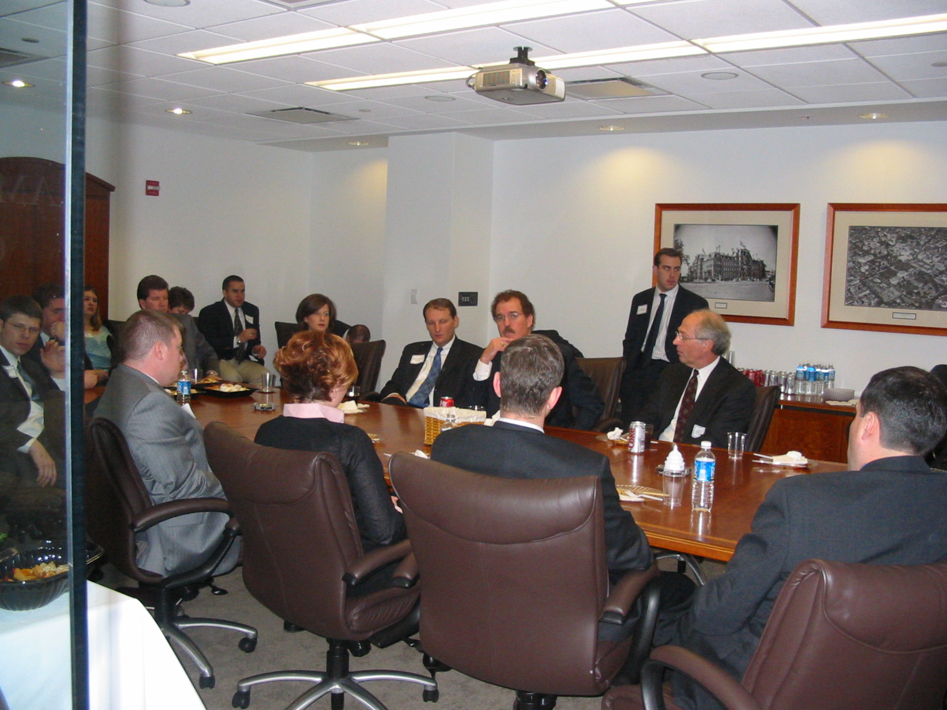
We need to be at this Table
Congressman Phil Gingrey, M.D.
Ophthalmologists
Radiology?
Psychiatric Assn.
Surgeons
Pathologists
Anesthesiologists
http://www.radpac.org

Slide 18
If we are not at the table,
WE will be
on the menu!

Slide 19
Legislative Advocacy
Someone benefits and someone’s ox is gored!
Notes:
Someone benefits and someone’s ox is gored
say more parks and green space
whose land do you confiscate or limit how they use their land,
who pays for it.
Victim and Player
19

Slide 20
How do you influence public policy
Relationships with your elected officials are a strategic key to our political success
Grassroots involvement is an important part in the political process
Notes:
Victim and Player
How do you influence public policy?
Relationships with your elected officials are a strategic key to our political success
Grassroots involvement is important in the political process
Political landscape has changed with rules for lobbying
No gratis golf game, dinner or coffee to a politician.
PACs - it is still legal to show up with a check from a PAC
Face to face meeting – participate often and bring your check
Air your concerns directly to your representative
It’s not a onetime event it requires ongoing involvement
They need to see you early in the process, not just in need of their favor.
If you are a friend and supporter before they get elected, then you are in a better position to be heard and make your case
American democracy is a participatory process
Money is a necessary lubricant in our political system, whether we like it, or not
Who’s been to Las Vegas
The saying is “Pay to play”.
20

Slide 21
Political Landscape
No gratis golf game, dinner, or coffee to a politician
PACs – it is still legal to show up with a check from a PAC
Face to face meeting – participate often and bring your check
Air concerns directly to your representative
Its not a onetime event. It requires ongoing involvement
They need to see you early in the process, not just when in need of their favor
If you are a friend and supporter before they got elected, then you are in a better position to be heard and make your case
American democracy is a participatory process
Money is necessary lubricant in our political system, whether we like it or not

Slide 22
Three rules of thumb about your elected official
Rule #1
Get elected
Rule #2
Get re-elected
Rule #3
Remember Rules #1 and 2

Slide 23
Member of Congress
Political
Friend
Campaign
Volunteers
Campaign/PAC
Contributors
½ Voters Vote for Opponents
Voters
(40-60% of Registered Voters Don’t Vote)
Registered Voters
Eligible Voters
(25% Can’t Legally Vote – age, non-citizens, etc)
Roughly 600,000 Constituents in Congressional District

Slide 24
Why Political Advocacy is Important
EVERYONE else is doing it!
Over 4,200 registered federal PACs
Congressional Office Saturation – EVERYDAY
Inbound emails: 200+
Faxes: 100+
Phone calls: 30-40
In-person visits: 3-5

Slide 25
How do we participate?
Individually
Usually not very effective
Unless you host a dinner or gathering to raise money for you “friend,” so they can get elected
Represent a group - “United we stand, divided we fall”
These are not easy times, money is tight and we are not alone in this process
“If we do not speak for ourselves, then who will?”
Radiology state chapter PAC
ACR PAC
Have you participated?
Have you encouraged your colleagues participation?
Notes:
How do we participate?
Individually
Not as effective
Unless you host an dinner or gathering to raise money for your “friend,” so they can get elected
Represent a group - “United we stand divided we fall”
These are not easy times, money is tight and we are not alone in this process.
“If we do not speak for ourselves, then who will?”
Radiology state chapter PAC
ACR PAC
Have you participated?
Have you encouraged your colleague’s participation?
25

Slide 26
Pieces to Political Puzzle
Political Action Committee (PAC)
Local Grasstops
State & DC Office Lobbying
Local Grassroots

Slide 27
ACR Organization
Radiology state chapters
Councilors and alternate councilors
Propose resolutions and vote on the floor of the AMCLC about ACR policies, guidelines, and standards
Elect members to the ACR Steering Committee, Officers of the Council and Board of Chancellors
Steering committee
Elected and appointed members
Duty to advise the direction of the ACR
Board of Chancellors
Governing board
Have the legal authority to and are charged with running the organization with the consent of the steering committee
ACR PAC
Notes:
Radiology State chapters
Councilors and alternate councilors
One councilor/alternate per 100 ACR members
Propose resolutions and Vote on the floor of the AMCLC about ACR policies, guidelines and standards
Elect members to the ACR Steering committee, Officers of the Council and Board of Chancellors
Steering committee – legislative
Elected and appointed members
who appoints these
Duties advise the direction of the ACR
Board of Chancellors
Governing board - executive
Elected and appointed members
Representatives from specialty societies
Have the legal authority to and are charged with running the organization with the consent of the steering committee
ACR PAC
Are you friends with or personally know a state or national elected representative. Let us know. It could make a difference in our political influence.
Rob Entel MD Radiologist Clearwater, FL
Grew up in Clearwater was close friend with Gus Bilrakis as a child. His Dad served decades as a US Congressman from the West coast of Florida. Now GUS is the US congressman.
27

Slide 28
ACR Medicaid Network Mission Statement
Our mission is to monitor the Medicaid policy and its funding, in our respective states, with special attention directed toward issues that impact the delivery of imaging and radiation oncology services provided by Medicaid.
In the service of this mission, the members of this network are charged with alerting the ACR Economics and Health Policy Commission, general membership and its staff, so that the ACR can work towards positively impacting the delivery of imaging services funded by Medicaid.

Slide 29
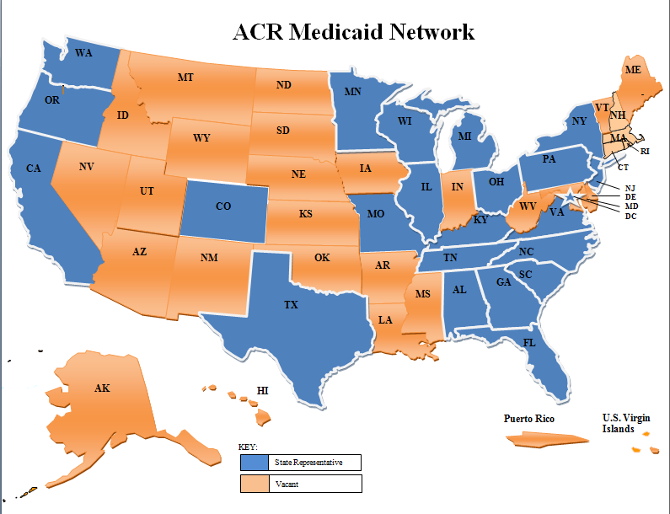

Slide 30
Looks at the data we got back
Table of average billing on the 10 exams we sent
Medicaid to medicare comparison

Slide 31
Help with this slide
Medicaid Success Story
Particulars in Vermont – reverse payment denial
When to call
Examples

Slide 32
Our numbers are small, but when we focus, we have been very effective in promoting our issues within the ACR
Educational programs
Imaging Gently
ACR – SPR conjointly sponsored Technical Standards and Practice Guidelines
Past and present members of the Board of Chancellors and Speaker of the council
Pediatric radiology caucus at the ACMLC
Notes:
Our numbers are small, but when we focus we have been very effective in our issues with the ACR
Educational programs
Education activities which have been co sponsored by the ACR and SPR
Image gently
ACR – SPR conjointly sponsored Technical Standards and Practice Guidelines
Past and present members of the Board of Chancellors and Speaker of the council
We have members that attend year after year who are Pediatric Radiologist from many States and we meet as a caucus during the AMCLC meeting and discuss ACR initiatives relative to Pediatric Radiology
One by product of this caucus is that we are not geographically limited and often vote in line with our like minded colleges who are Pediatric Radiologist
Been successful in electing a couple of our fellow Pediatric Radiologist to significant ACR offices
Mention some who have been involved
Bill McAllister
CAQs SPR representative
Helped start the Pediatric caucus
Charlie Williams
State Chapter President
ACR Steering committee
Don Frush
SPR - ACR collaboration
Board of Chancellors
Marilyn Gosky
Image gently
Carol Rumack
University Colorado
Ultrasound / Pediatric Representation
Philip Lund
Oregon Radiology Society President
Kate Fienstein
State Illinois President
SPR ACR Councilor
Sarah Abramson
New York President
ACR SPR Councilor
David Kushner
Speaker of the council
Kimberly Applegate
Speaker of the council
32

Slide 33
A few who have been involved
Bill McAllister
Charlie Williams
Don Frush
Marilyn Gosky
Carol Rumack
Philip Lund
Kate Feinstein
Sarah Abramson
David Kushner
Kimberly Applegate
Notes:
Mention some who have been involved
Bill McAllister
CAQs SPR representative
Helped start the Pediatric caucus
Charlie Williams
State Chapter President
ACR Steering committee
Don Frush
SPR - ACR collaboration
Board of Chancellors
Marilyn Gosky
Image gently
Carol Rumack
University Colorado
Ultrasound / Pediatric Representation
Philip Lund
Oregon Radiology Society President
Kate Fienstein
State Illinois President
SPR ACR Councilor
Sarah Abramson
New York President
ACR SPR Councilor
David Kushner
Speaker of the council
Kimberly Applegate
Speaker of the council
33

Slide 34
Now specific requests?
Encourage and support at least one or two members from your radiology department
Every state will then have representation in the grass roots of running our organization and from this pool of active Pediatric radiologists, we can draw upon members of this group to address the Medicaid issue more effectively
I recommend two individuals because there is a little bit of an additive or symbiotic relationship that is likely to occur
Also, we need to mentor our younger colleagues so that it continues over time
The ACR also has a process whereby they have rotating membership to committees to encourage fresh ideas and develop leadership. We should do the same.

Slide 35
Participate in the ACR PACs process
It is your physician representative in the ACR that will bring the message back home to you and your department
By being active in this process, issues relating to Pediatric Radiology become more highlighted
If we sit back and let someone else do it, we abdicate our influence in our participatory democracy and are likely to become the victim in this arena
Pay to play democracy

Slide 36
Lastly
Lead by example, on being an advocate for our specialty
The economics of our profession do matter; let our colleagues know its important
Unfortunately, its not just about the science and medicine
Be our eyes and ears – help us, help you!

Slide 37
With each step we take together, we are stronger…

Slide 39
Medicaid Compared to Medicare Payment PC Rates – Good, Bad and the Ugly
FL, CA, MI, WA | 40-45% cuts
MA, WV, MN | 30-38% cuts
CO, MO, OH, SC, TX, UT, WY | 20-28% cuts
GA, HI, IL, KS, NC, PA, VT | 10-19% cuts

Slide 40
Florida Medicaid vs Medicare Payment Rates
Procedure | CPT Code | Medicare Professional Component (PC) | FL (PC) | Medicaid Cuts
Chest radiograph AP | CPT 71010 | 8.83 | 5.29 | -40.09
Chest radiograph AP & LATERAL | CPT 71020 | 10.87 | 6.31 | -41.95
Abdominal radiograph AP | CPT 74000 | 8.83 | 5.29 | -40.09
Brain MRI without contrast | CPT 70551 | 73.73 | 42.95 | -41.75
Brain MRI without & with contrast | CPT 70553 | 117.9 | 68.2 | -42.15
Brain CT without contrast | CPT 70450 | 42.13 | 24.84 | -49.28
US Kidneys | CPT 76770 | 36.69 | 21.37 | -41.76
Esophagram & UGI | CPT 74240 | 34.66 | 20.16 | -41.83
CT Abdomen & Pelvis with Contrast | CPT 74177 | 88.68 | 51.1 | -42.38
Nuclear Medicine Voiding Cystogram | CPT 78740 | 28.88 | 16.9 | -41.48
Florida Medicaid Average Cuts
 |  |  |  | -42.276

Slide 41
Notes:
41

Slide 42
North Carolina: Medicaid Economics for Radiology
FFS for Radiology, but at 86% of Medicare (PCP’s at 95%)
Cost of billing the PC only for radiographs often exceeds actual payments
RBM imposed: NC Medicaid wrote an at risk contract with MedSolutions in return for a fixed budget for imaging and a $100 Million “savings”.
For every dollar of state savings, $3 federal matching funds also “lost”. Total provider revenue impact: $400,000,000 per year (TC and PC).
MedSolutions raises provider administrative costs, denies payments, decreases volume, and diverts more funds from local providers
IDTF’s prohibited from providing Medicaid services
This is an unsustainable provider business model for Radiology.
Currently starting discussions on OEDS process with in CCNC to displace the RBM process, lower costs, and improve care. If Radiology provides UM services, it should also participate in the shared savings process.
Notes:
42

