Slide 1
Real Data to Inform Real Decisions.
Without credible, evidence-based research, we cannot effectively inform policy that supports the value of radiology in the evolving team-based health care model.
$3M⁺
125⁺
$50M
Amount of funds awarded
for Neiman HPI research grants.
Number of peer-reviewed papers published thanks to grants from the Neiman HPI.
Amount restored per year in reimbursements to radiologists thanks to Neiman HPI research.

Slide 2
What is 10 for Tuesday?
The ACRF will be joining the larger movement with our new 10 for Tuesday campaign. GivingTuesday is celebrated on the Tuesday following Thanksgiving and is designed to inspire and prompt generosity and giving after the deluge of shopping on Black Friday and Cyber Monday.
Our goal with this campaign is to inspire our own giving movement within the radiology community to help secure our profession's future. We are kicking off the campaign this month and it will end on the day of GivingTuesday, December 3.
By giving just $10 each, radiologists across the country can come together to
collectively take an active role in ensuring that the radiology profession not only
survives, but thrives.

Slide 3
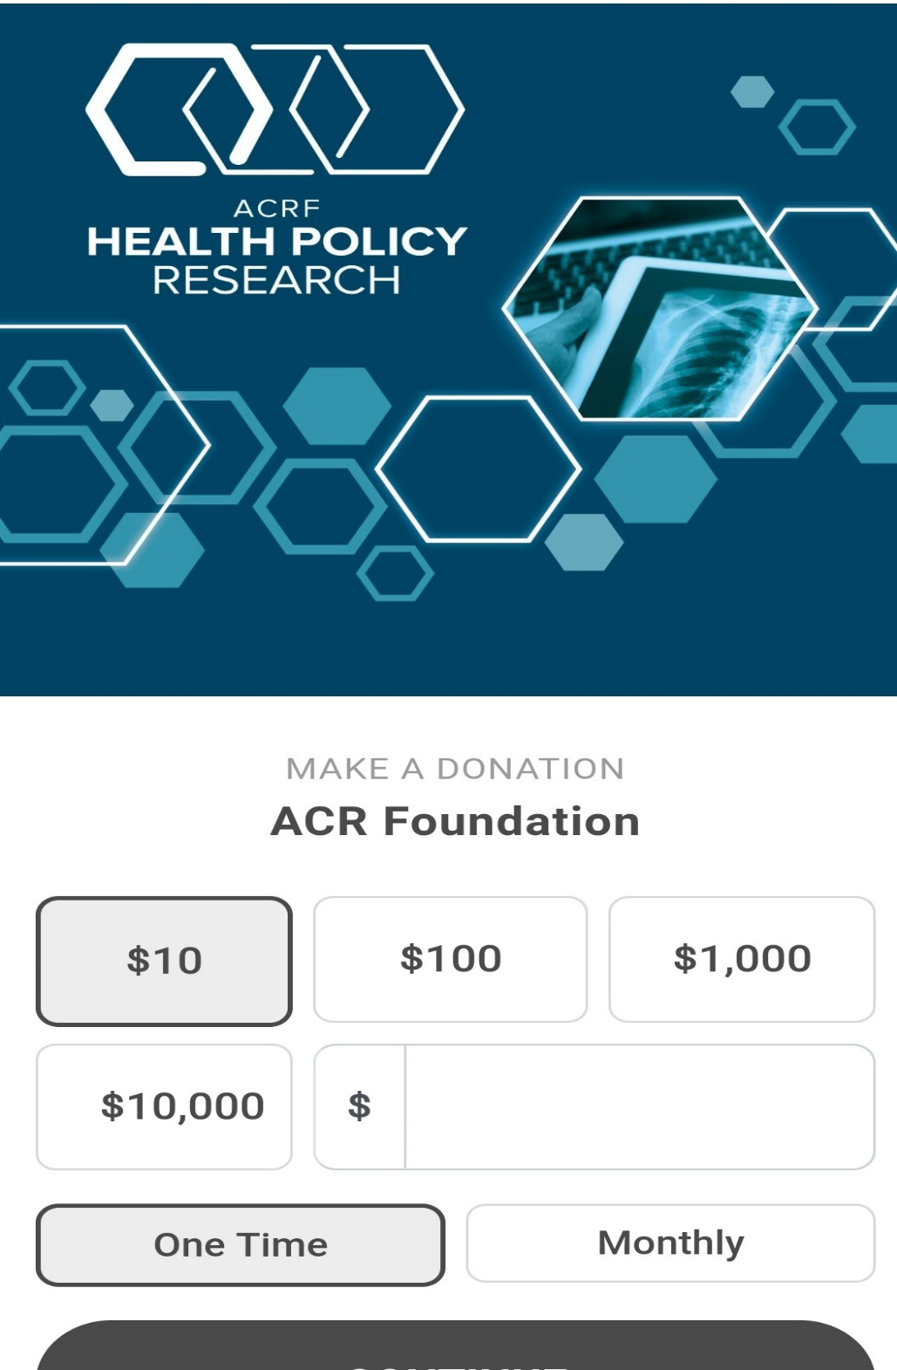
Join the
10 for Tuesday
Movement.
1
Text “HPR10” to 44-321.
2
You will receive a text from 44-321. Click the link in the text.
3
Fill out the form and click the continue button.

